Slide 1
Interviewing
News Gathering

Slide 2
What makes a great interview?
Award-winning journalist Ben Montgomery is author of the narrative non-fiction book Grandma Gatewood’s Walk, and a finalist for the Pulitzer Prize for a series about abuse in a Florida reform school published in the Tampa Bay Times.
Hear him talk about what he thinks makes someone great at interviewing.
Notes:
Link to video Montgomery 1 00:57

Slide 3
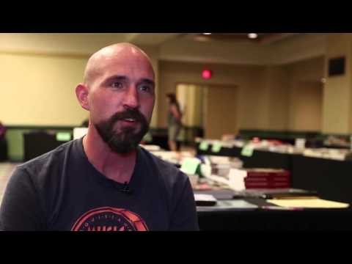

Slide 4
Discuss: What did Montgomery say?
Be curious. Why?
Research the subject and the person you’re interviewing. Why?
LISTEN and be empathetic. Why?
Notes:
Curiosity will help you think up good questions.
Research helps you get good information in interviews. It helps you think of good questions to ask and to anticipate what the answers might be. Teachers: Note for your students that Montgomery is a seasoned professional who has practiced interviewing for years. They will be asked to write questions. This is to help them learn the process.
Listening and understanding help you to follow up on unexpected information. Empathy helps your subject to want to open up and talk to you.

Slide 5
TV news journalist Katie Couric offers these other interviewing tips:
Be warm, open, a good host.
Ask questions that don’t require a yes-no answer. Why?
Particularly for broadcast, remember your audience. Let the subject communicate. Discuss.
Notes:
Yes-no answers are deadly on the air. You have to ask questions that will get people talking.
She also said the research helps her to plan follow-up questions.
3. Similar to what Montgomery said, Couric noted that it’s frustrating to a radio or TV audience if someone says something significant and the interviewer is so focused on the next question that he/she doesn’t hear and doesn’t follow up.

Slide 6
INTERVIEWING
How to plan and conduct an effective interview – and what to do after it’s over

Slide 7
What kind of interview is it?
Live, one-on-one, also known as a formal interview
Short interview (just a few questions)
Person on the street (or in the hallway)
Press conference
Panel discussion
Q-and-A format
What do these have in common?
Notes:
All of these types of interviews are ideally conducted face-to-face. If broadcast, they must be in person, but for online and print, this is true as well.
Formal interview is a vocabulary question.

Slide 8
Why have an in-person conversation?
It’s easier to establish a relationship and build trust face-to-face.
You can note facial expressions, body language and tone of voice in person.
You can make observations for background and context.
Sources are usually more comfortable in their own environment.

Slide 9
Things can go right or wrong in any interview.
Ben Montgomery discusses the importance of letting your source feel comfortable.
Notes:
Link to Montgomery 3. 01:57

Slide 10
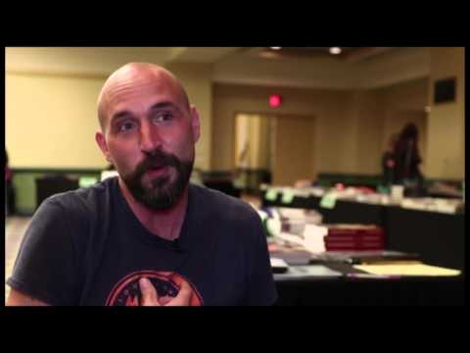

Slide 11
What if in-person isn’t possible?
Phone
Email
Skype, Google Hangout, FaceTime
What are the pros and cons of each?
Notes:
Teachers: Emphasize the importance of face-to-face interviews. That’s obvious for broadcast, but not to print reporters.
Other pros/cons: Email – no personal interaction. Lag time between questions makes it hard to ask follow-up questions. Are you 100 percent certain that the person who wrote the email is who you think they are? Advantage of email: gives interviewee time to ponder the question and give a good anser. Offers flexibility. Allows copy-paste for quotes. Provides a record of what is said.
Telephone call: It’s impersonal. You can’t see what people look like. Can’t record without an expensive gizmo. You can mishear.
Advantage of telephone: It’s fast and efficient.
Texting, etc: Similar to email, but with perhaps more immediacy. Good for short, quick quotes and fact-checking. You MUST be sure the person you are texting, FB, etc., is really the person you think it is.

Slide 12
Handle with care …
Texting, social media messaging, chats, email and other electronic communications:
Use for setting up interviews, follow-up or fact-checking — but not for actual interviewing
Verify identity and authenticity of the person answering text or email (call to confirm)
Notes:
Only when an in-person interview or phone conversation is not possible should reporters rely on electronic communication. Editors should develop a policy in their staff manual with clear expectations for email and text message use in reporting. This may include drawing distinctions between personal and media staff email addresses. Just because an email address says a person’s name does not mean that person sent the message. Similarly, sources may leave email or social media accounts open and cell phones unattended. It’s possible that a different user responded to questions or posed as someone else by using their accounts.

Slide 13
If one way of reaching someone isn’t working, “be willing to try something different,” Montgomery says.
Notes:
Link to Montgomery 4. 00:56

Slide 14
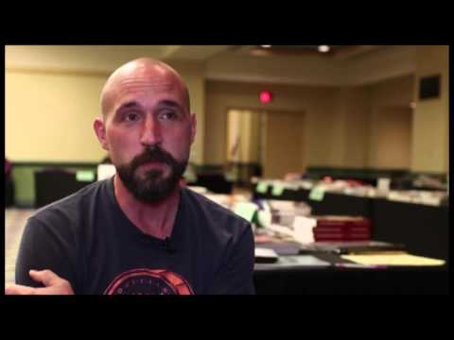

Slide 15
INTERVIEWING
Here comes the nitty-gritty: What you need to do to make sure your interviews
are successful.

Slide 16
Before you RESEARCH and WRITE QUESTIONS, you must ask yourself:
What do I know about my topic and the story I think I’ll write?
How do I know what I know?
Where should I go to find out more?
Who will be the best sources for my story?
How can I find experts on my topic?
Notes:
This is all about research. Discuss possible sources.

Slide 17
Next, do your research.
Preliminary research will help you …
determine a story angle
decide who to interview
gain background knowledge of your sources.
What resources should you use
for research?
Notes:
Internet searches, database research on topic, library. Magazine related to the topic. Press releases.

Slide 18
Then, develop your questions.
Write open-ended questions to avoid a simple yes or no, or one- or two-word response.
Ask questions that will make your source answer with an in-depth response.
Notes:
Although Ben Montgomery said he never writes questions, he’s a professional -- and he goes in with LOTS of questions in his mind. Explain that until your students are making $50,000+ a year and have a successful book contract, they need to write questions before the interview. This is not to prescribe an interview, but to help them focus on what they need to know and how to ask for the information they need.

Slide 19
Develop your questions
Plan ahead: Your first questions should create a comfortable, conversational tone.
Your first questions should prompt your sources to open up and invite them:
to speak anecdotally
to share information about themselves
to tell you what they know about the focus of your story.
Notes:
Opening questions are often called “softball” questions.

Slide 20
Develop your questions
Write a LOT of questions. Create a long list; prepare questions on everything you can think of that comes up in your research.
But do not expect to ask them all.
Listening is critical.
Be ready to ask an unprepared question when you get an unexpected response.

Slide 21
Ben Montgomery discusses the importance of research and listening.
Notes:
Link to Montgomery 2. 01:05

Slide 22
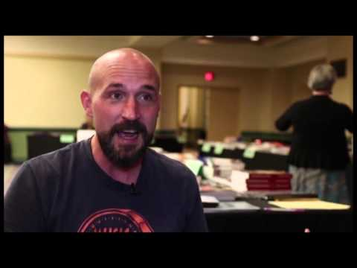

Slide 23
Three tips:
Do your research.
Ask open-ended questions: Why? How? What happened?
LISTEN to the answers! Then ask follow-up questions.

Slide 24
Before you go … check your tech
Whatever equipment you use, make sure:
batteries are charged.
memory card is in camera, phone or recorder.
the environment is conducive (not too much background sound or bad lighting).
pens have ink.
reporter’s notebook is at hand with prepared questions.

Slide 25
Ben Montgomery explains how to approach the people you need to interview.
Notes:
Link to Montgomery 5. 02:39

Slide 26
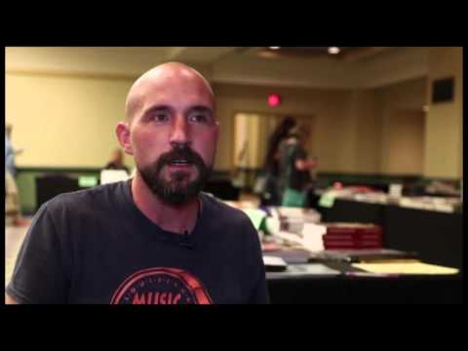

Slide 27
Before the interview…
Visualize what will take place.
Practice asking your questions and anticipate types of responses you might receive.
Know who you are going to interview and where you will find that person.
Set an appointment for a formal interview.
Notes:
And then be there on time!

Slide 28
Before the interview...
Let the sources know how you will record the interview and why you will record it using those methods.
In some states, you must legally get the source’s permission on tape (or memory card) before you record him or her.

Slide 29
Conducting the interview
Start with an informal chat.
Ask your source to spell his/her first and last name.
Ask adults what title they want to use.
Let the source tell you about his/her role in the story.
Notes:
INFORMAL CHAT lets student reporters establish some comfort for themselves as well as the source.
Teachers, emphasize the importance of names, grades and titles. This will save a world of problems later on.

Slide 30
Conducting the interview
Get a conversation going.
Take notes, especially of things the source says that are good quotes.
Observe the source and make notes about the environment.
Ask questions about things you see.
What might you learn about a source from his/her environment?
Notes:
Often students will think they don’t need to take notes if they are recording an interview. Tell them to use their notebook to mark where the quote is on the recorder’s minute counter. But also make notes in case the technology fails and because quotes are MUCH easier to find in a notebook than in a recording.

Slide 31
Conducting the interview
Listen carefully.
Rephrase answers for clarification.
Be ready to ask follow-up questions.
As interview concludes, always ask: “Is there anything you’d like readers to know?” Or “Is there anything I forgot to ask?”

Slide 32
Concluding the interview
Get contact information – an email or cell phone number.
Explain that you may call for follow-up questions and to double-check the quotes you use in the story.
Checking facts is essential. Read back quotes to check for accuracy – not to allow sources to change their story.

Slide 33
INTERVIEWING
When the interview is over, you’re not quite done.

Slide 34
Transcribe the interview and highlight your notes
Transcribe recorded interviews as soon as possible. Generally, you will NOT transcribe the entire interview – that takes too much time!
Use your notes to decide what quotes you will need. Highlight your best quotes.
Go to the essential responses you will use in the story and transcribe those.
Be accurate and prepare copy-ready quotes and paraphrases.

Slide 35
Final notes
The interview is the key to fresh, timely, original journalism.
It’s OK to be intimidated or nervous talking to people you don’t know. Most people are!
Start off with smaller assignments and shorter interviews to build your confidence.

Slide 36
Student David Perez, who conducted the interview with Ben Montgomery, summarizes what he learned.
Many thanks to the following students from CCNLive, Christopher Columbus High School, Miami:
David Perez Anthony Martinez Victor Prieto Phillip Bootsma Antonio Castellanos (Editor)
Notes:
Link to David’s reaction 01:04

Slide 37
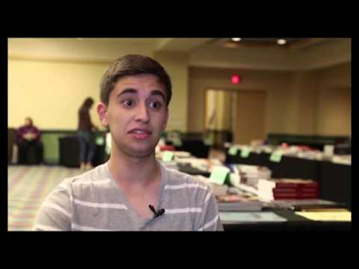

Slide 38
Final notes
The more you interview, the better you will become at it.
Keep asking questions!
Be curious.
There are untold stories walking the hallways of your school.
Go get them!

