Slide 1
Reporter’s Guide
to Digital Note Taking Tools
News Gathering

Slide 2
Using smart devices as digital note pad
with Evernote or Google Keep apps.

Slide 3
Why?
busy
on-the-go
too much to remember
need reference

Slide 4
Benefits
organization
archives
keywords & tags
mobile, web, cloud sync
research goes with you
digital note taking to the extreme
smart notebooks

Slide 5
Evernote Set up
create account online
download for desktop & mobile
turn on sync

Slide 6
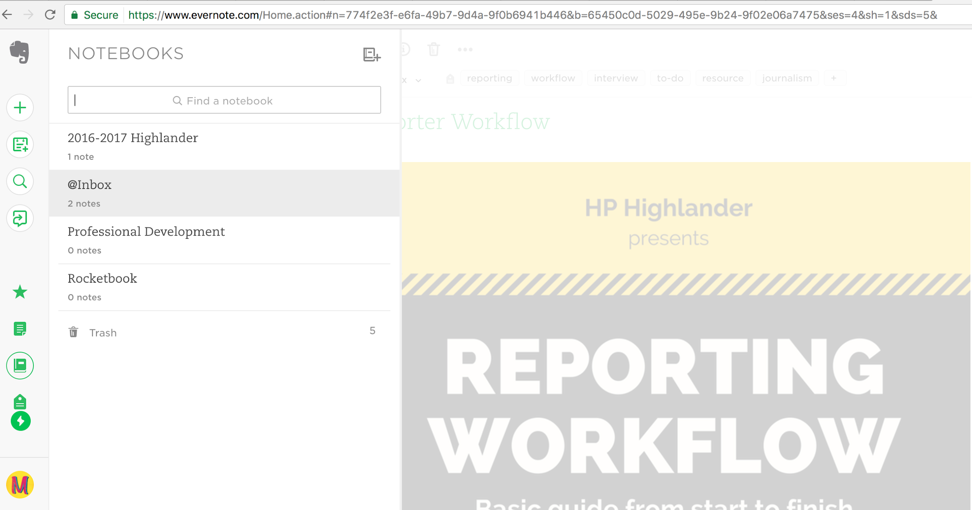
web version

Slide 7
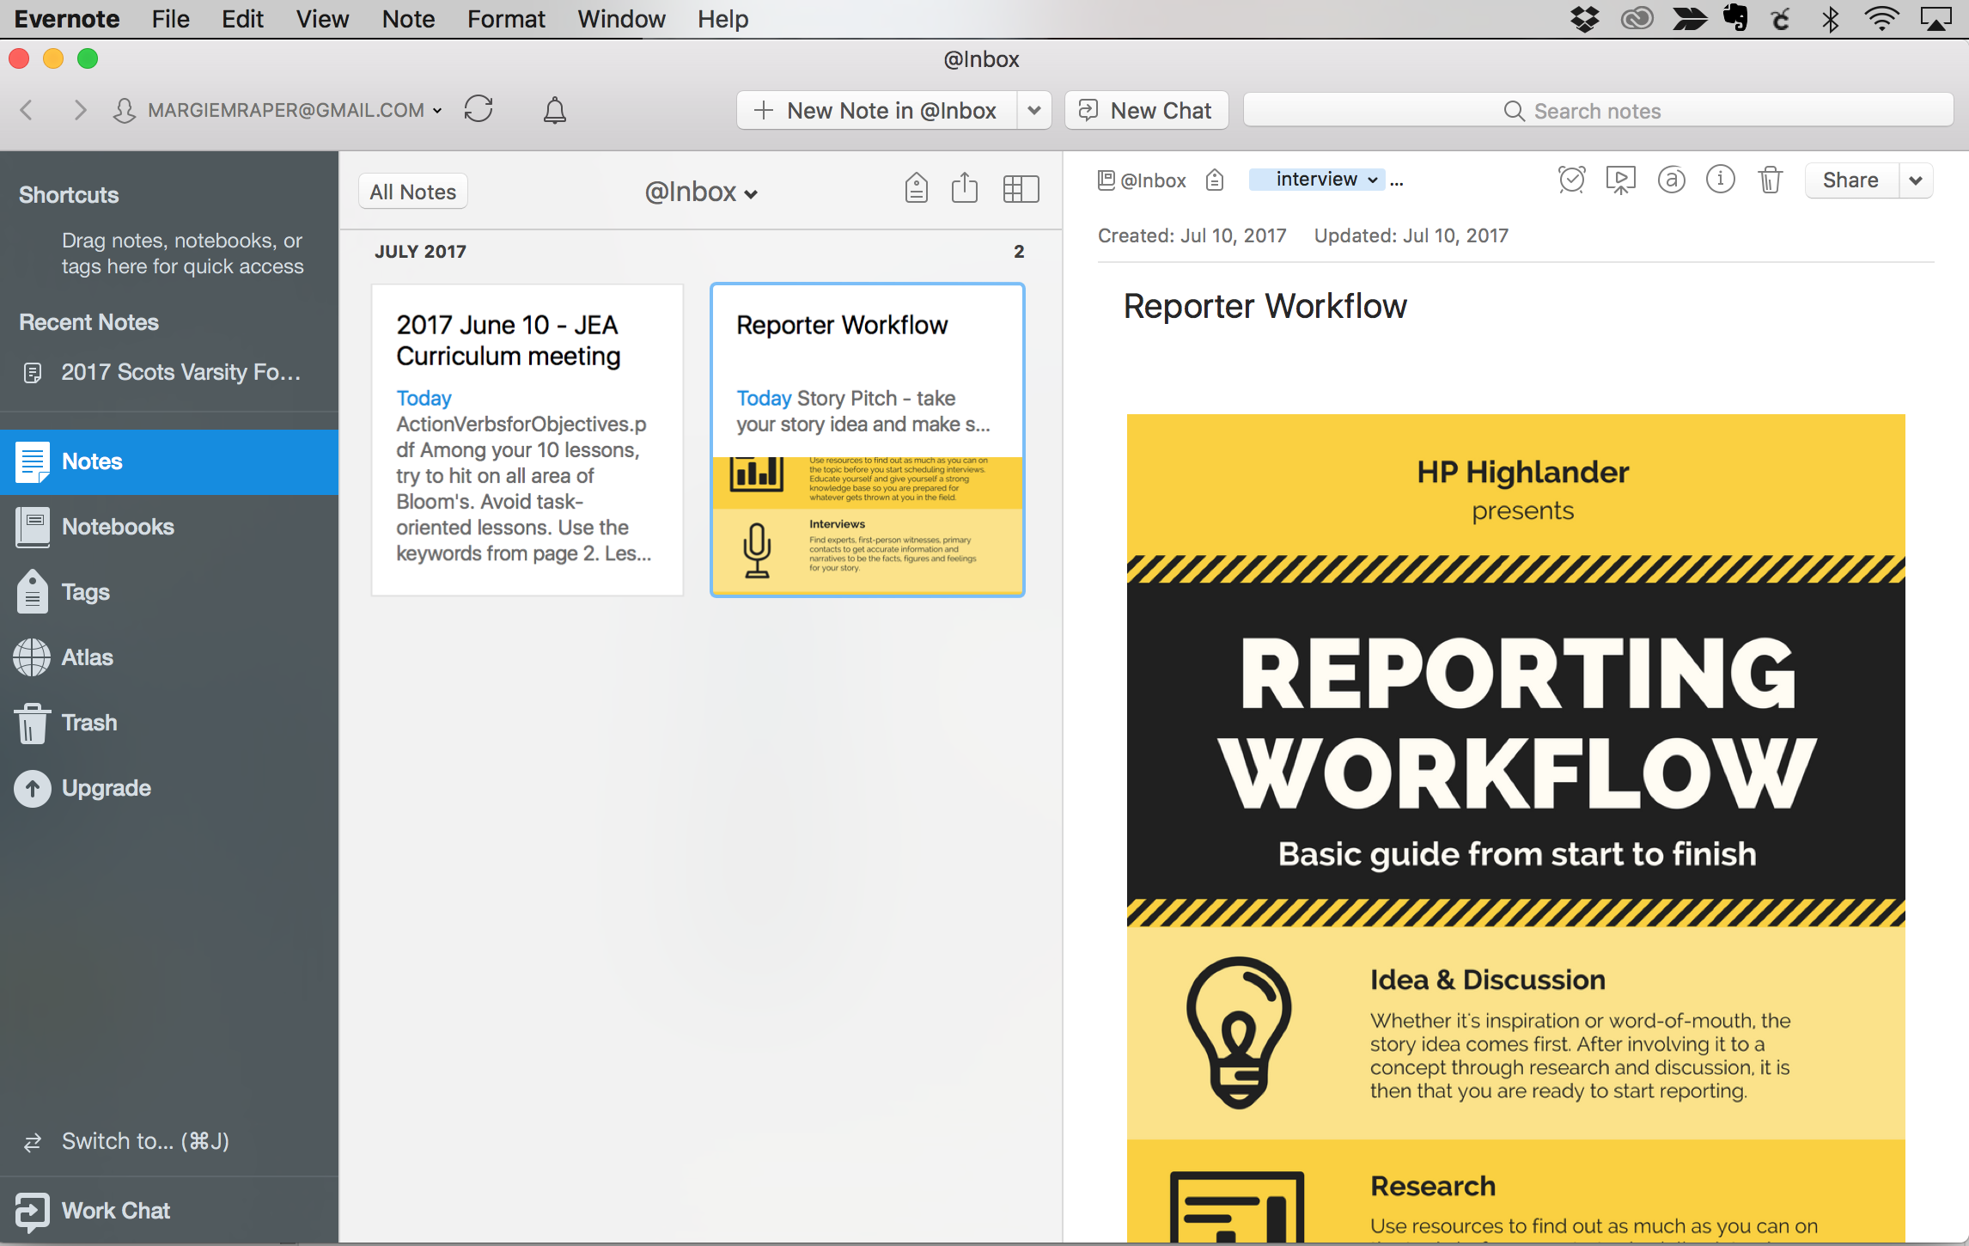
web version
desktop version

Slide 8
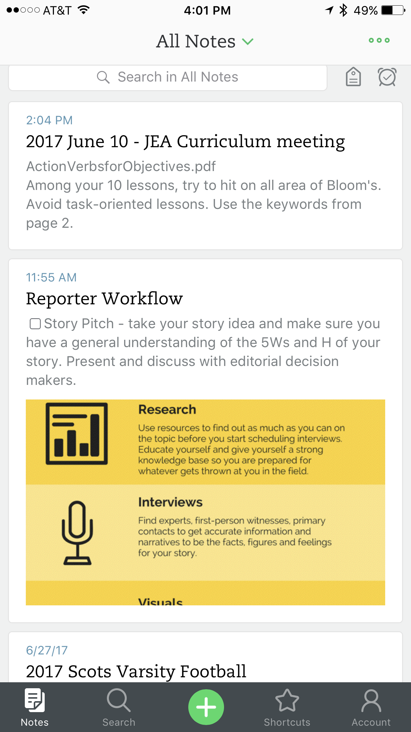
web version
mobile version
desktop version

Slide 9
Additional plug-ins
Webclipper - web clippings
Skitch - drawing, annotations
Scannable
Popularity of Evernote means lots of third-party options
Notes:
Plug ins for computer are free downloads.
Webclipper doesn’t have an exact mobile app. There are paid versions of webclipper apps
Skitch does have a free mobile app.

Slide 10
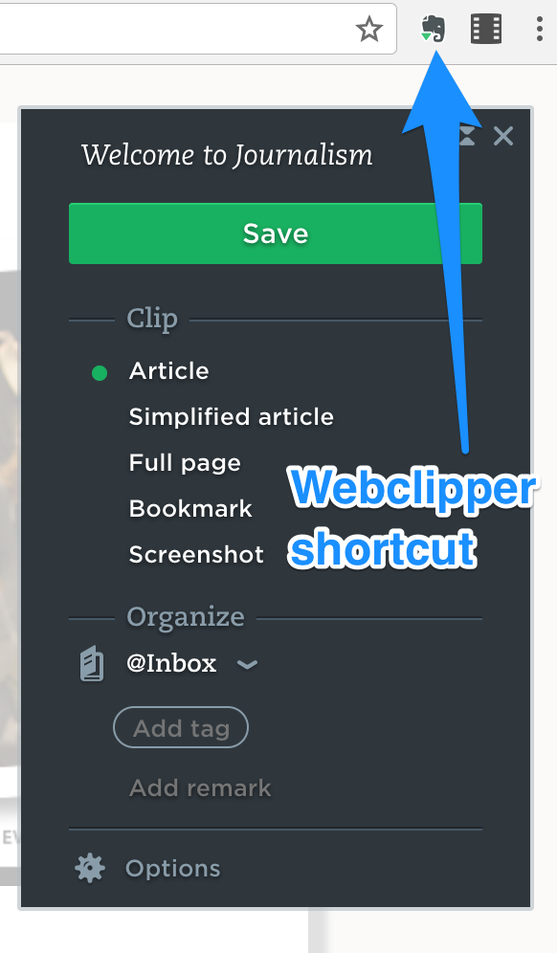
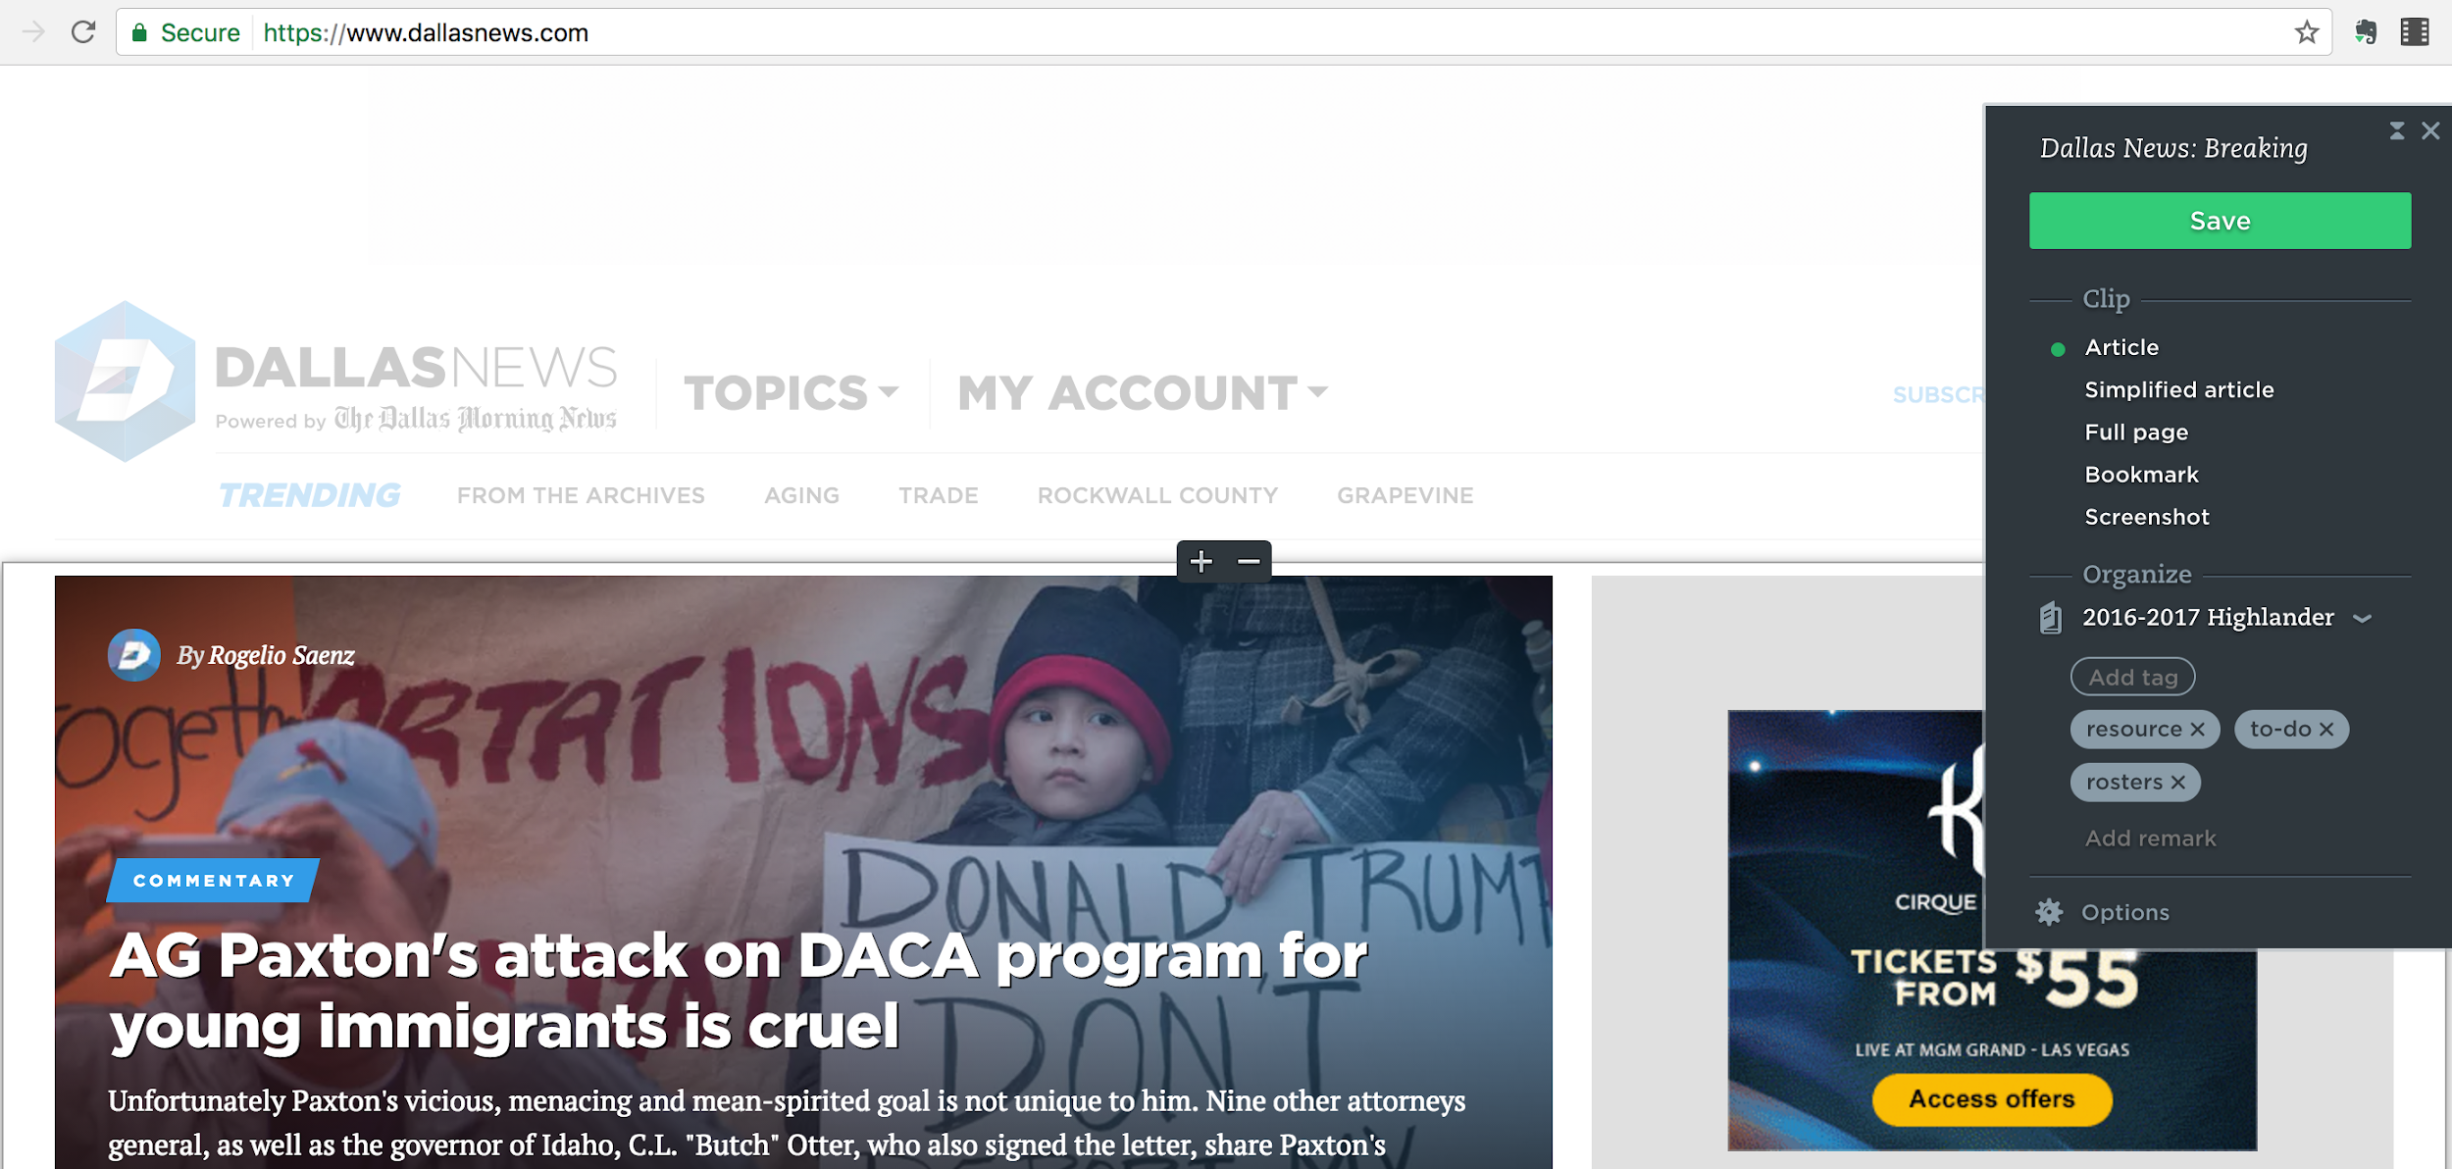
Webclipper
Notes:
Webclipper is a short cut

Slide 11
Skitch
Notes:
Skitch is a plugin for Evernote that lets you draw and mark up screenshots.

Slide 12
Set up - Organization
Notebooks
Tags
Make choices how you want to index work

Slide 13
Sample notebooks
Keep them simple

Slide 14
Organization
Notebooks
Create a logical structure for you
Develop staff organization together
Establish naming conventions
Tags
add searchable tags
topics, keywords, authors, tasks, status
Make choices how you want to index work

Slide 15
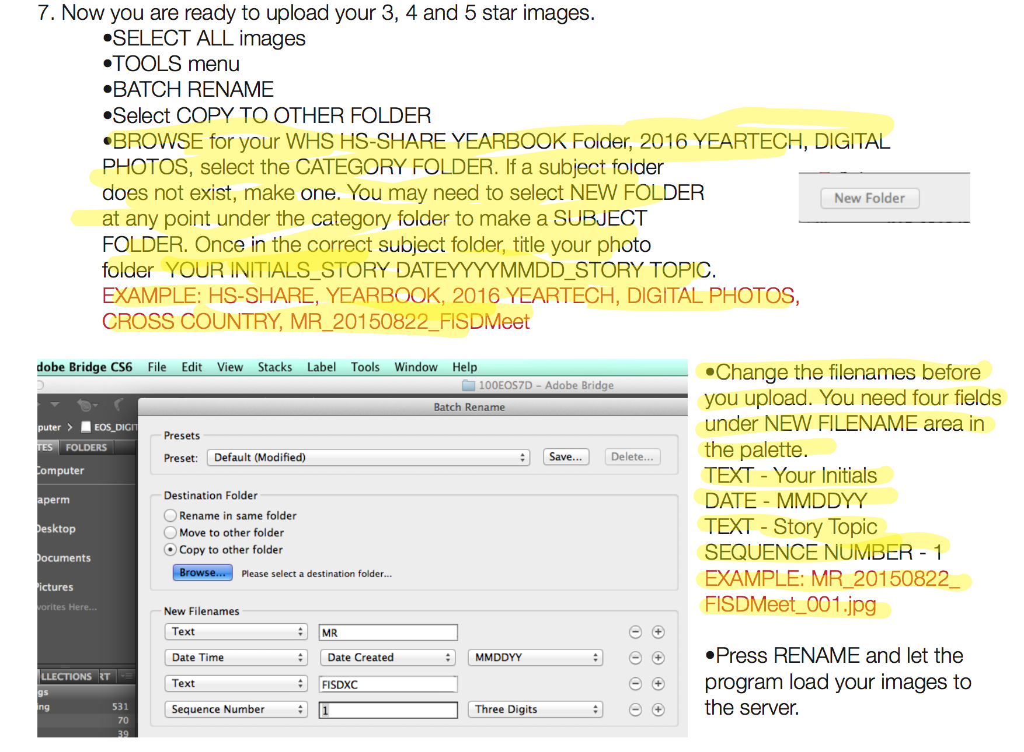
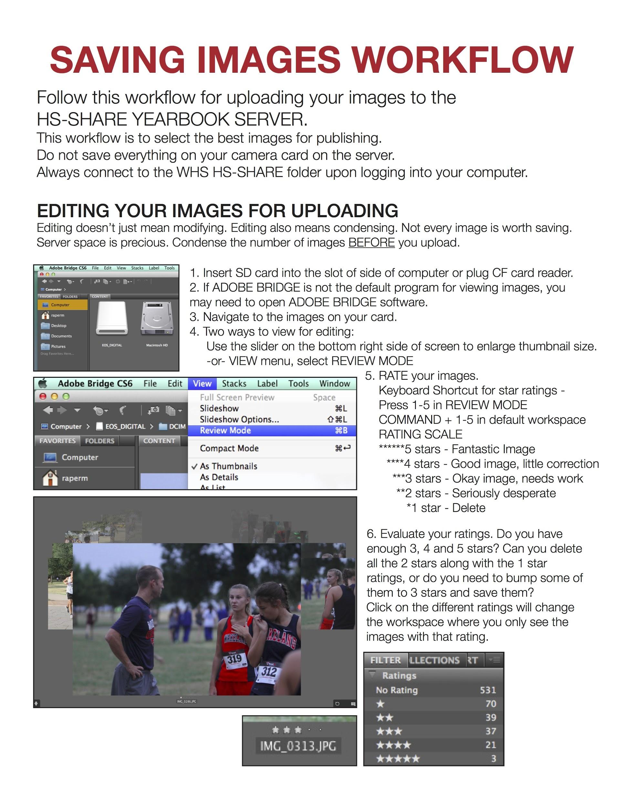
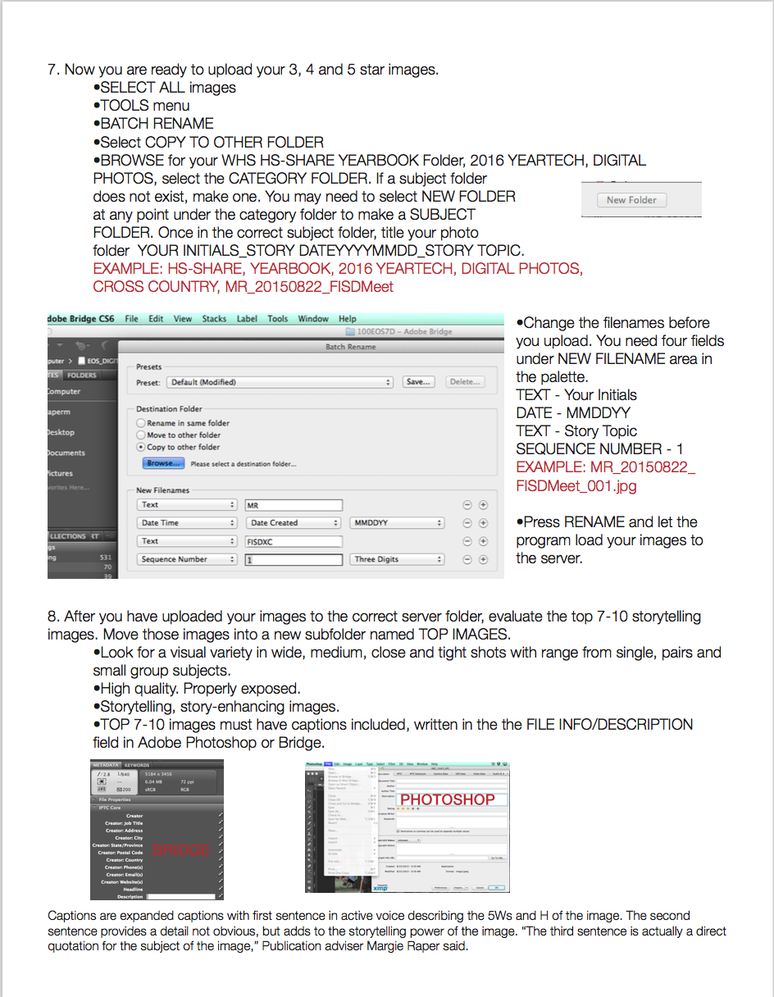
Naming conventions

Slide 16
Features
Annotating
Audio recordings
Cloud syncing, sharing

Slide 17
annotation

Slide 18
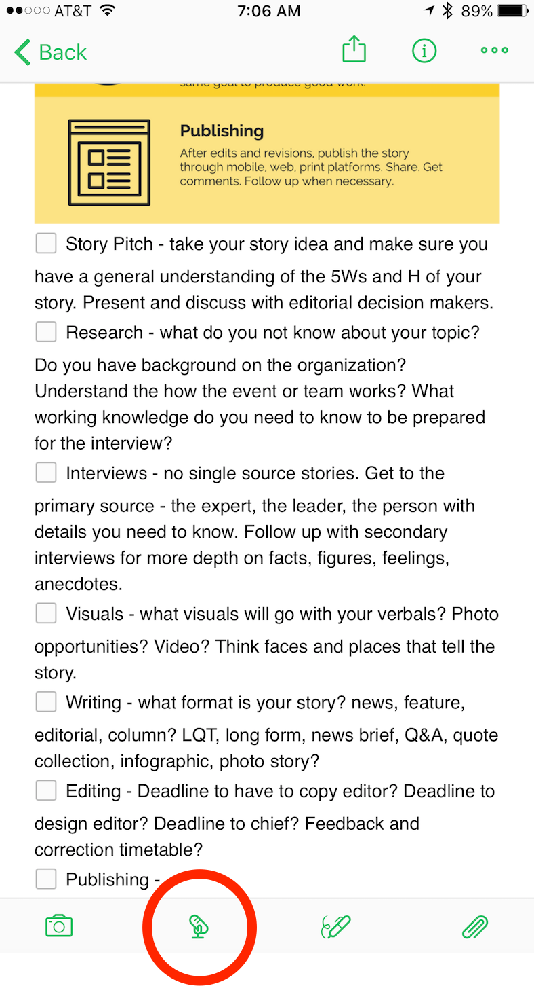
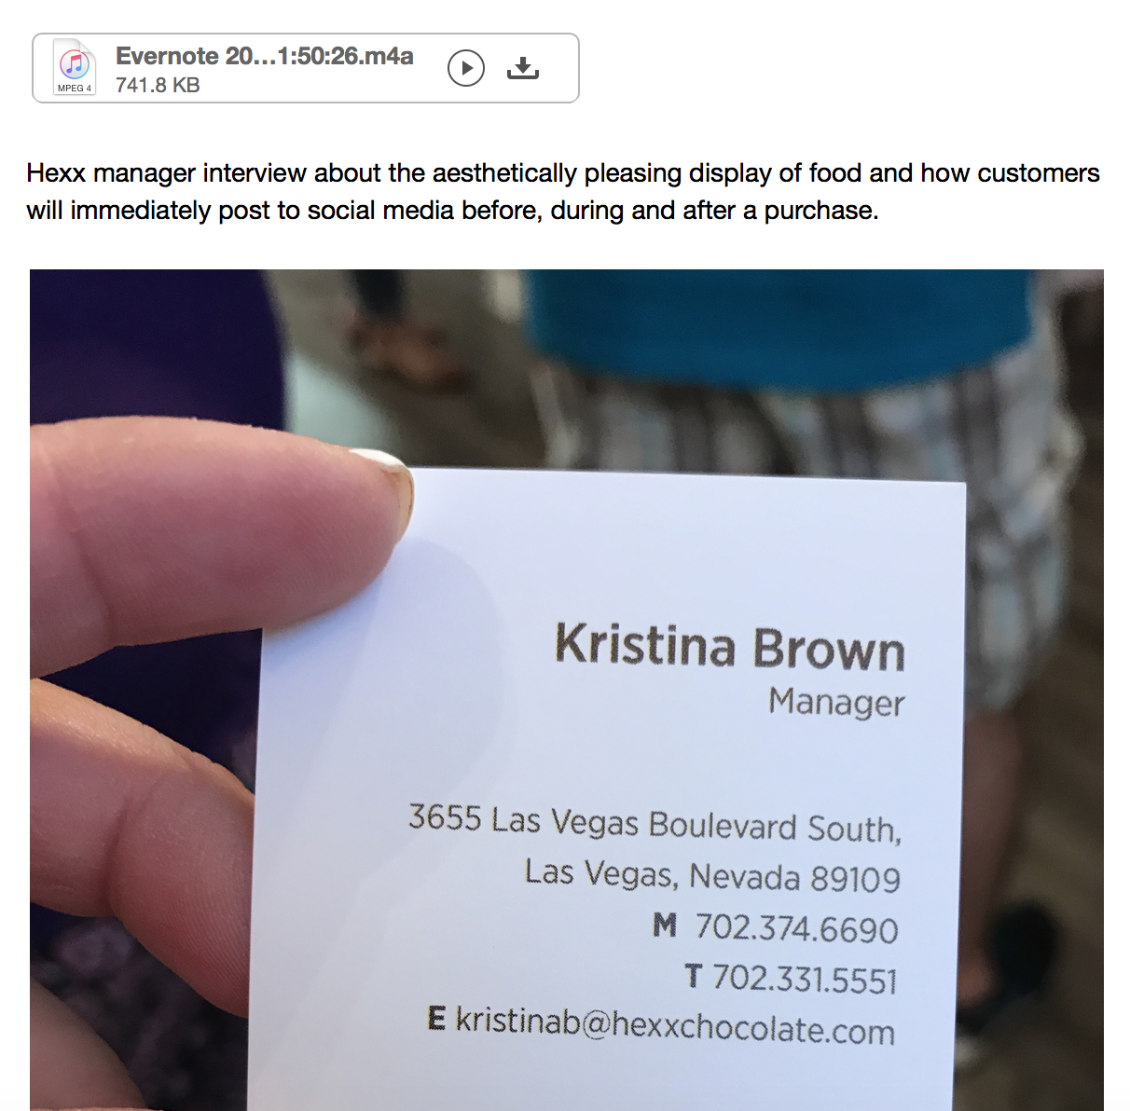
audio recordings

Slide 19
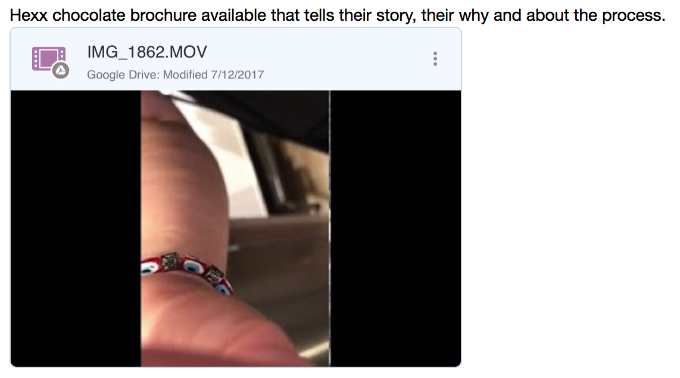
attachments & links

Slide 20
Smart Notebooks Sync with Evernote
Moleskine smart notebooks
Rocketbooks
Cloud syncing, sharing

Slide 21
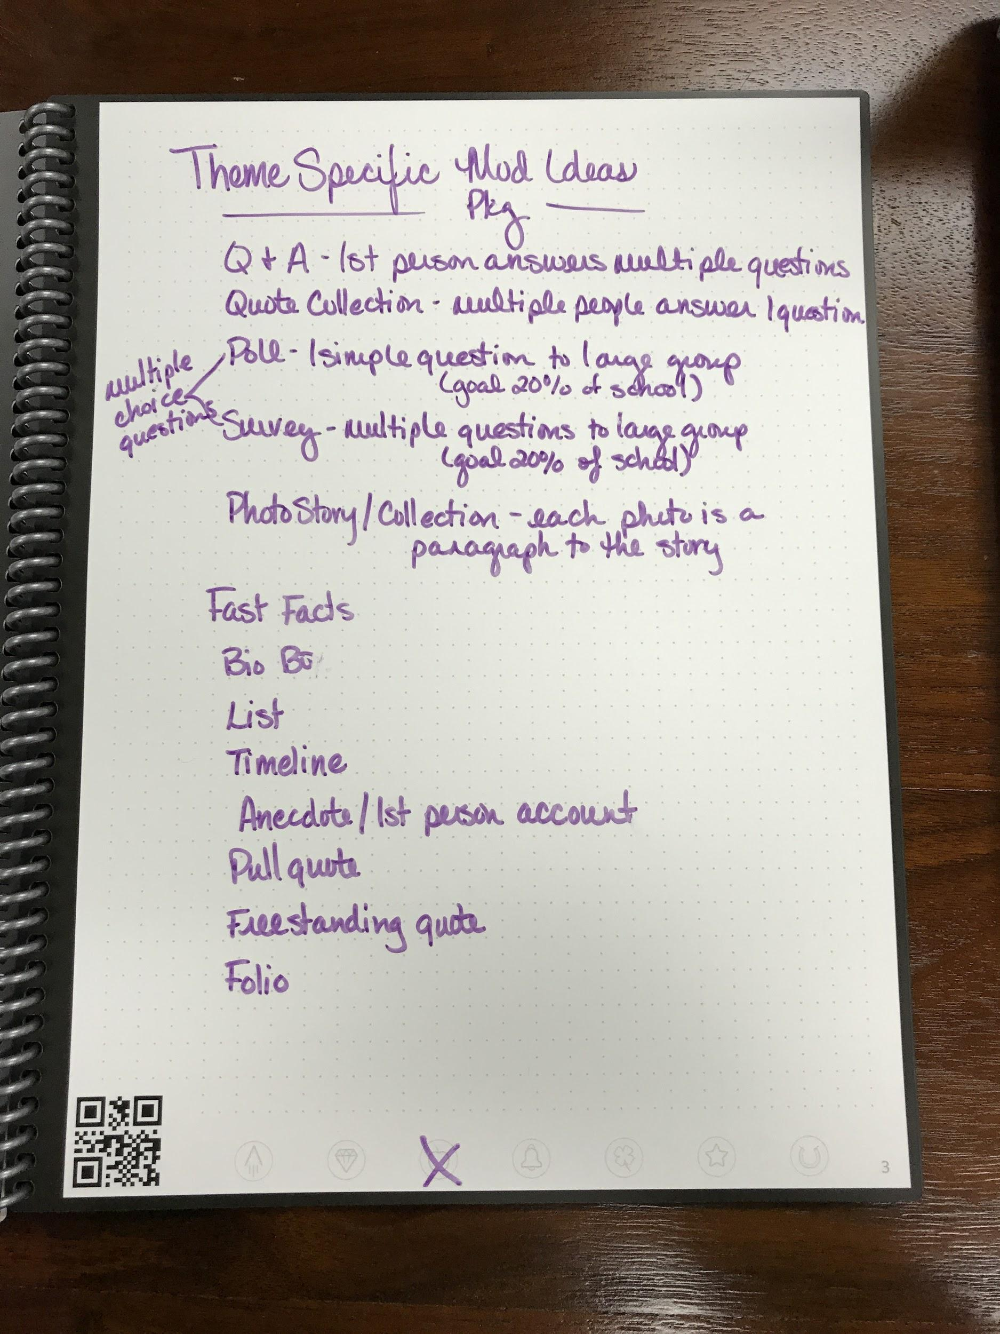
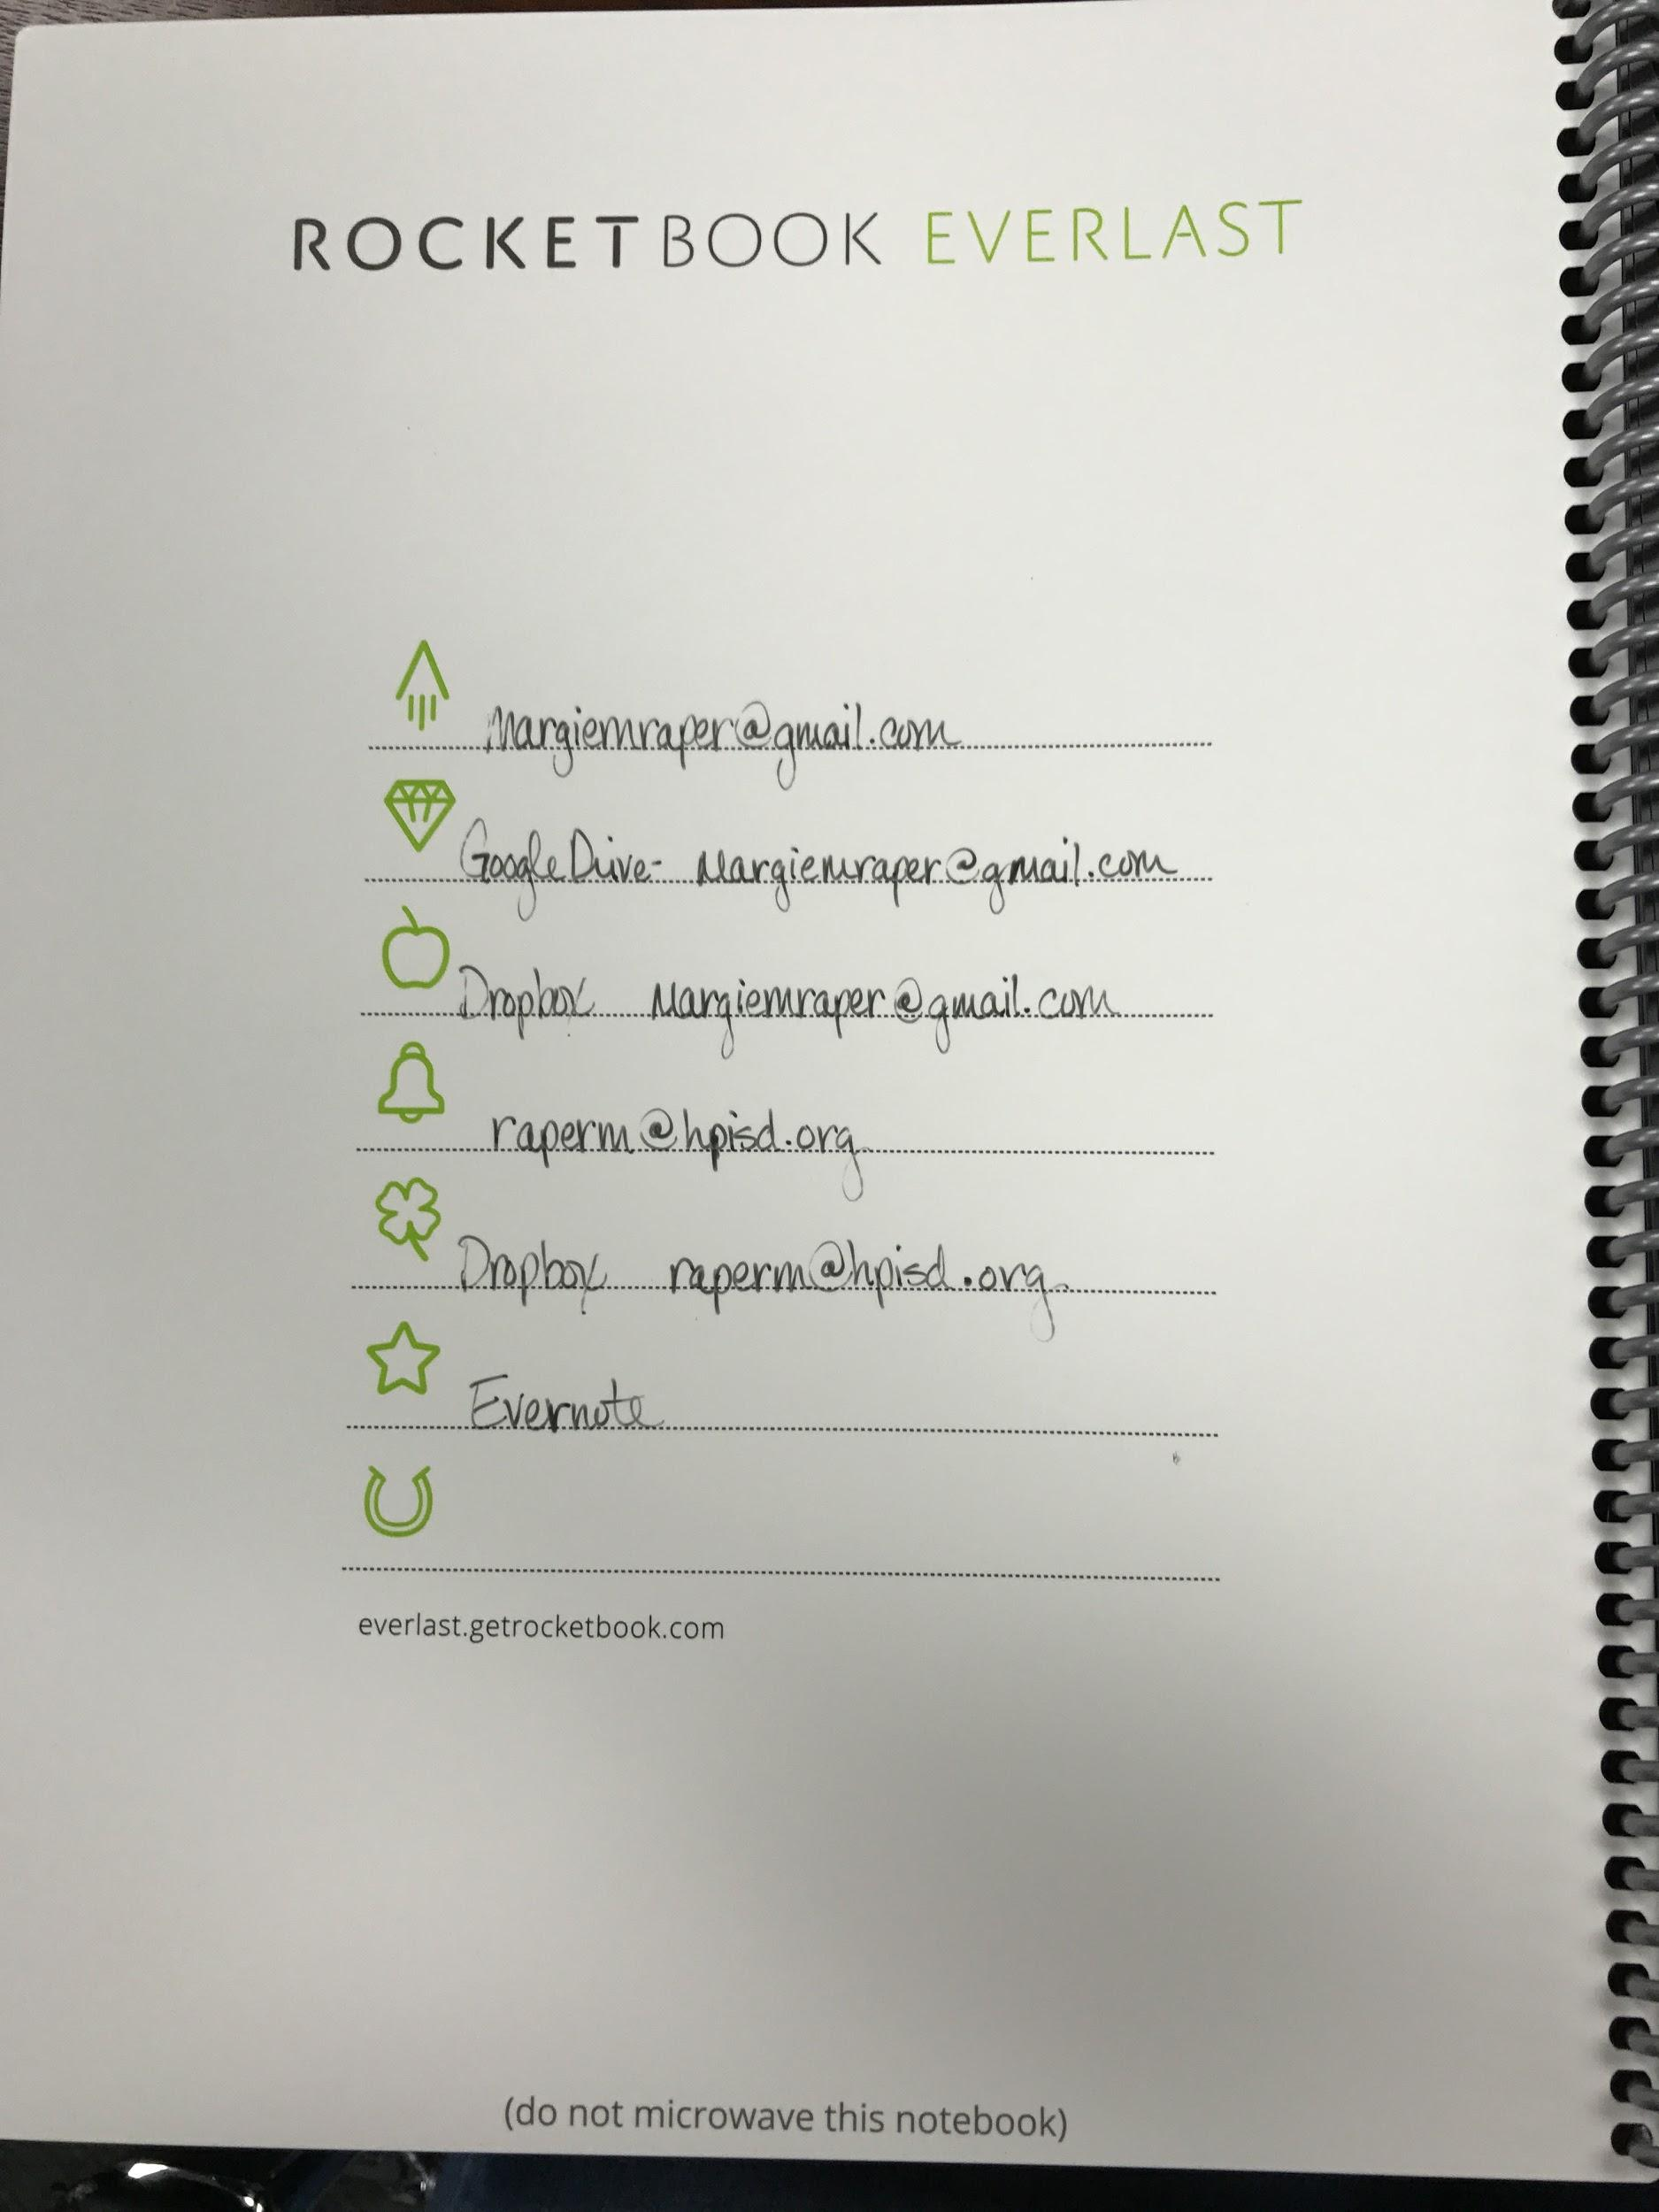
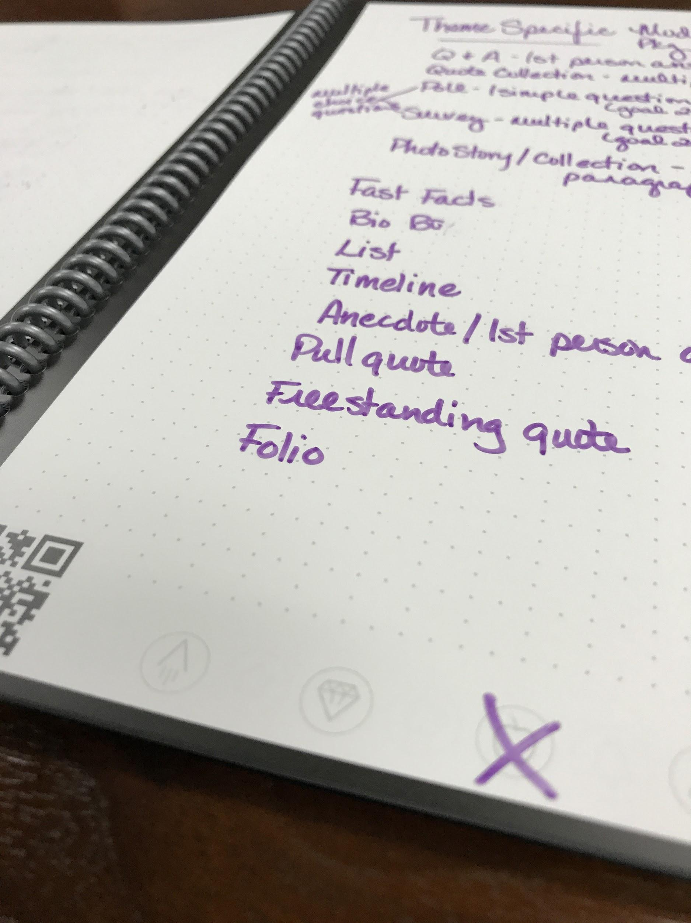
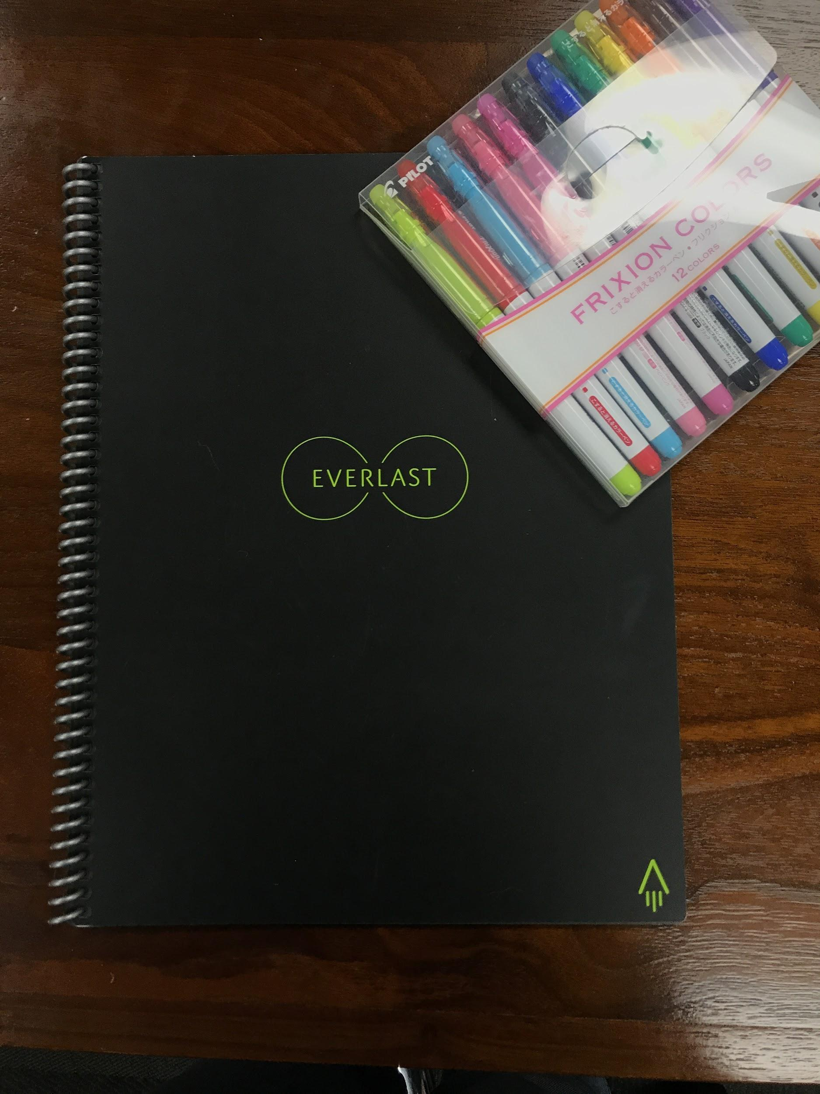

Slide 22
Google Keep Set up
Download the Google Keep app
Log into Google account on device & desktop

Slide 23
Features
Take notes
Make lists
Capture photos and audio
Digital dictation
Location-based reminders
Labels and color coding
Sharing and collaboration
Quick search for keywords
Sync across devices

Slide 24
Digital Dictation
Record voice memos
When you stop talking, the transcription will automatically pop up on the screen.
The transcription becomes a new note.
Title your note.
Notes may have photos, drawings, recording and checkboxes.
Additional edits available date & time, location, colors, labels and collaborators
Feature in mobile app only, syncs with web

Slide 25
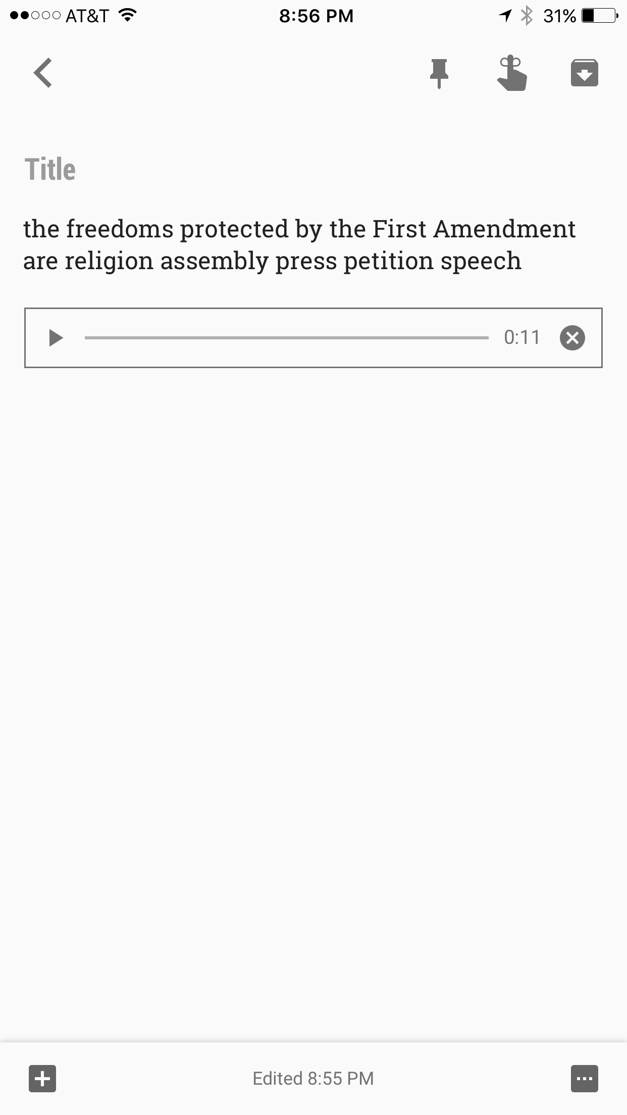

Slide 26
Optical Character Recognition
Read your handwriting and transcripts to text for you
Take or load photo of handwritten notes
Select “Grab Text Image”
Keep will transcribe for you.
It’s not perfect, but you can edit.
Then annotate, highlight, draw

Slide 27
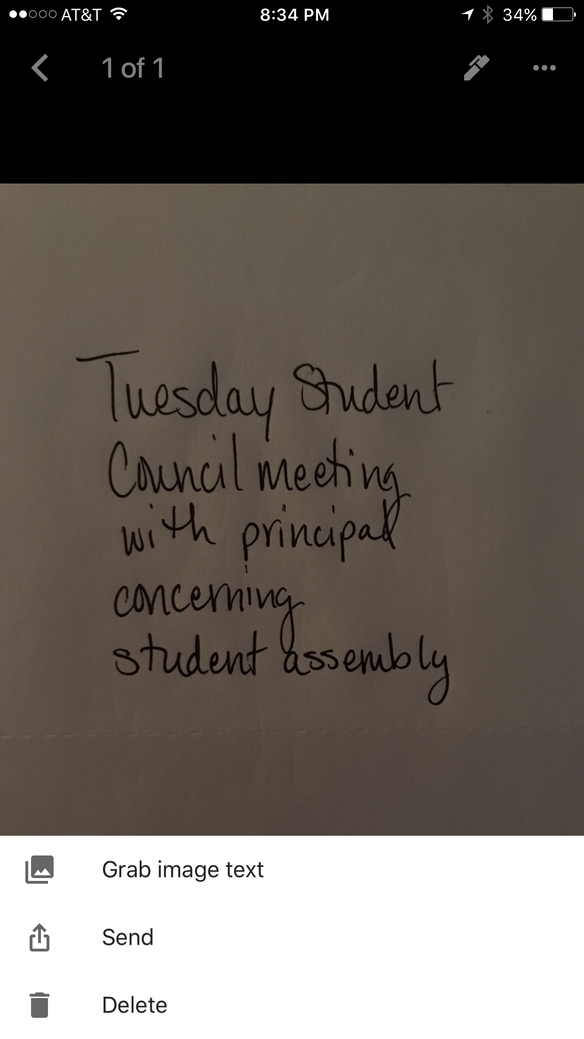
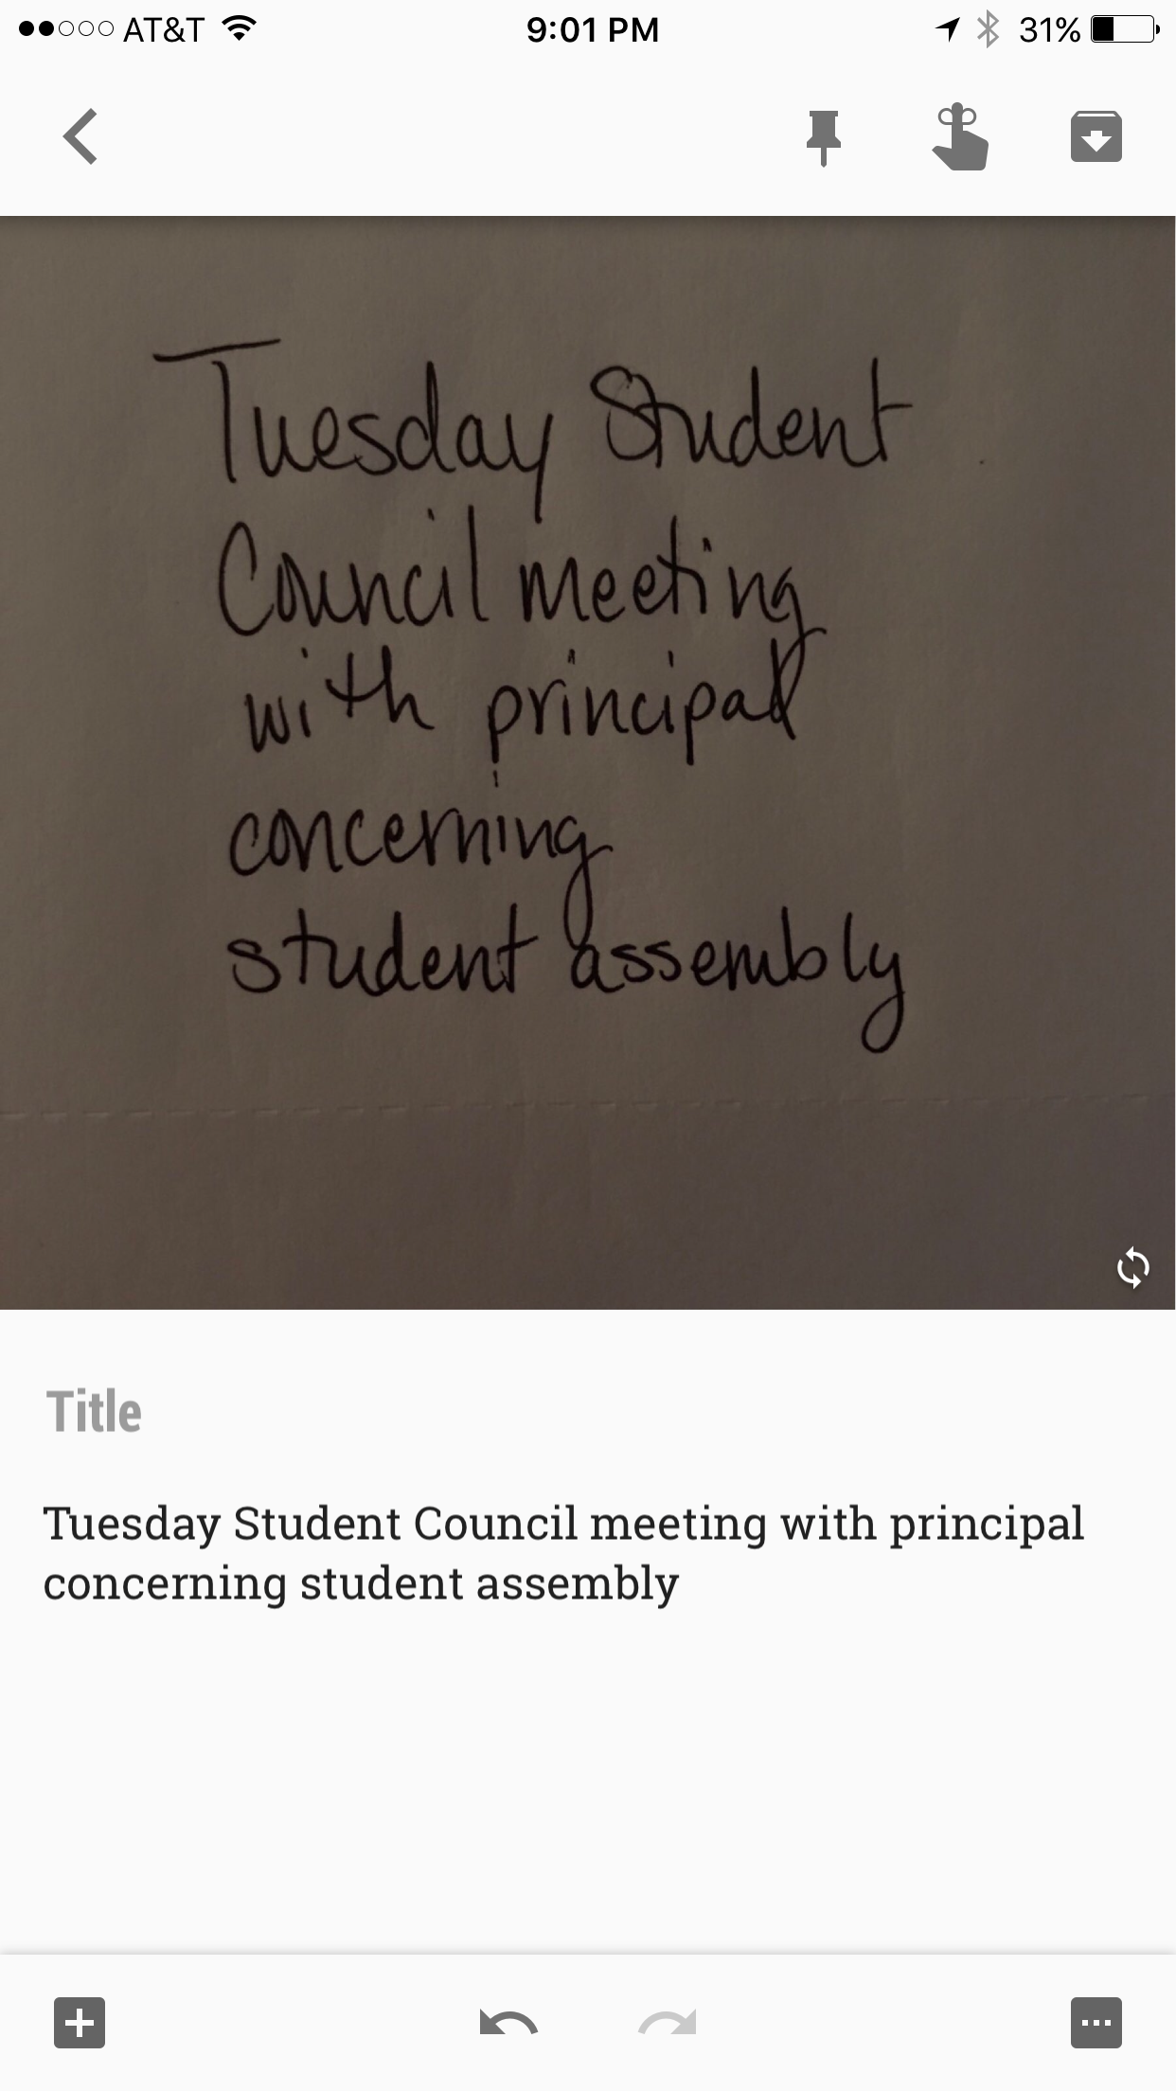

Slide 28
Tools
Custom features with pen tool for variety in drawing and annotating
Notes in Keep integrate easily into Google Docs
Color coding
Labels
Set reminders
Reminders can sync with Calendar and SMS text notifications
Reminders based on Locations with Addresses

Slide 29
