Slide 1
The Power of How and Why
How curiosity can lead to great storytelling
Entrepreneurship

Slide 2
It's all storytelling, you know. That's what journalism is all about.
Tom Brokaw

Slide 3
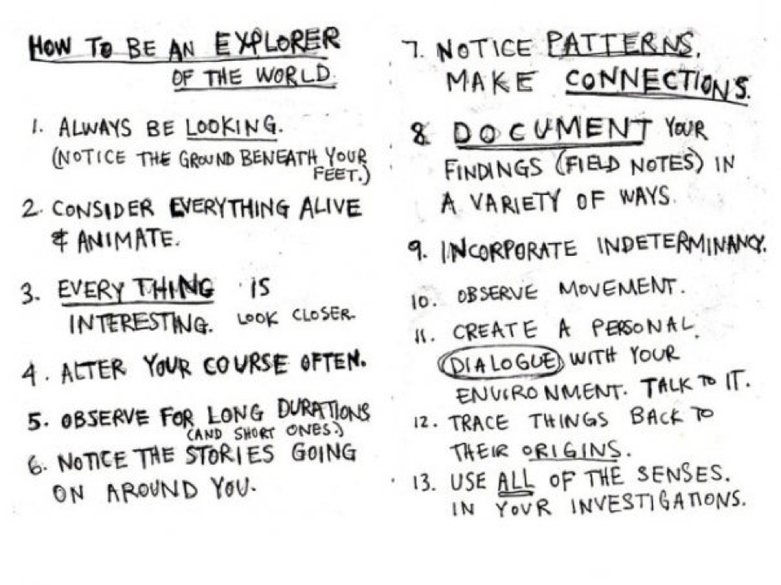
What are the characteristics of an explorer that are also good characteristics of a journalist?
From How to be an Explorer of the World: Portable Life Museum, by Keri Smith

Slide 4
As you examine the stories that follow, ask yourself these questions:
How do the questions “how” and “why” make a difference to understanding this person?
How is your first impression changed or deepened upon reading the story that goes with each photo?
All photos from Humans of New York blog

Slide 5
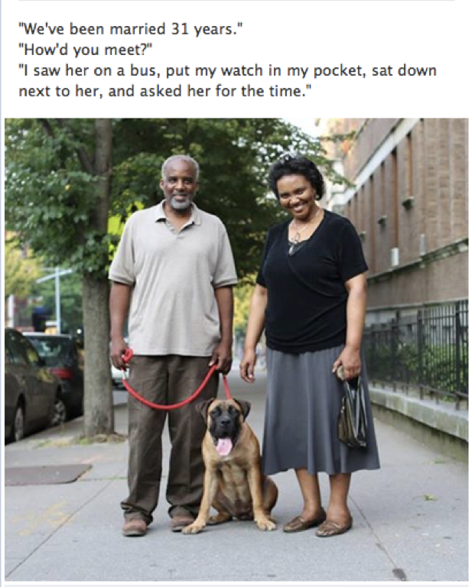
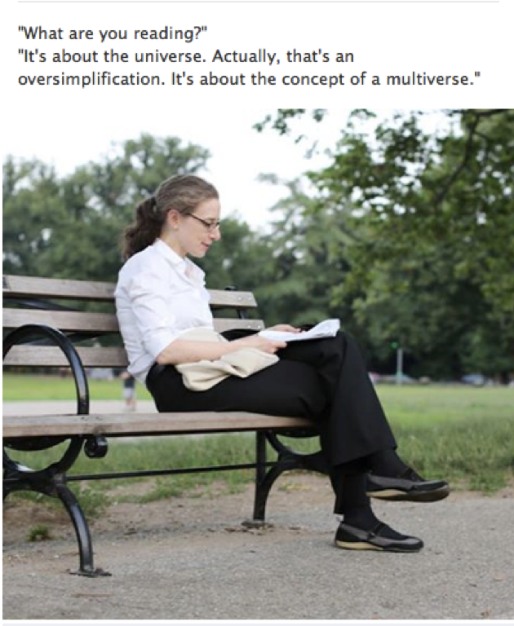

Slide 6
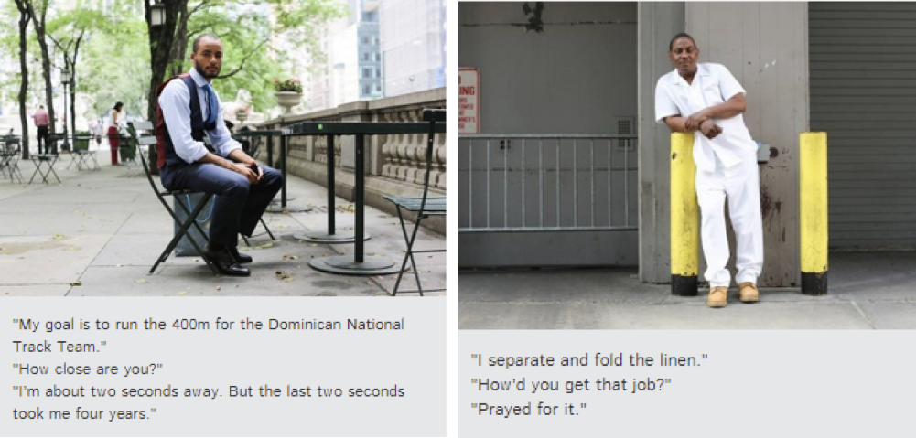

Slide 7
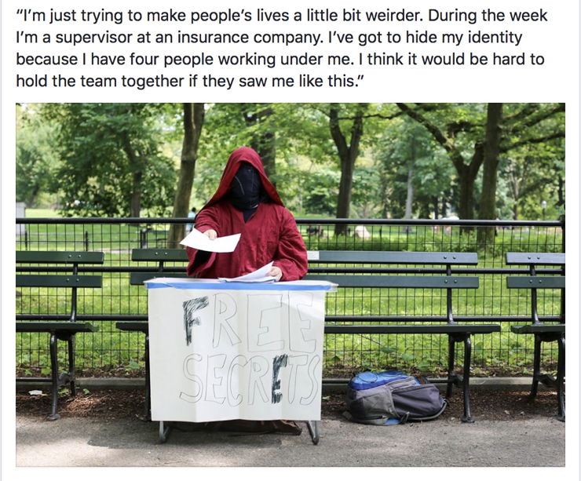

Slide 8
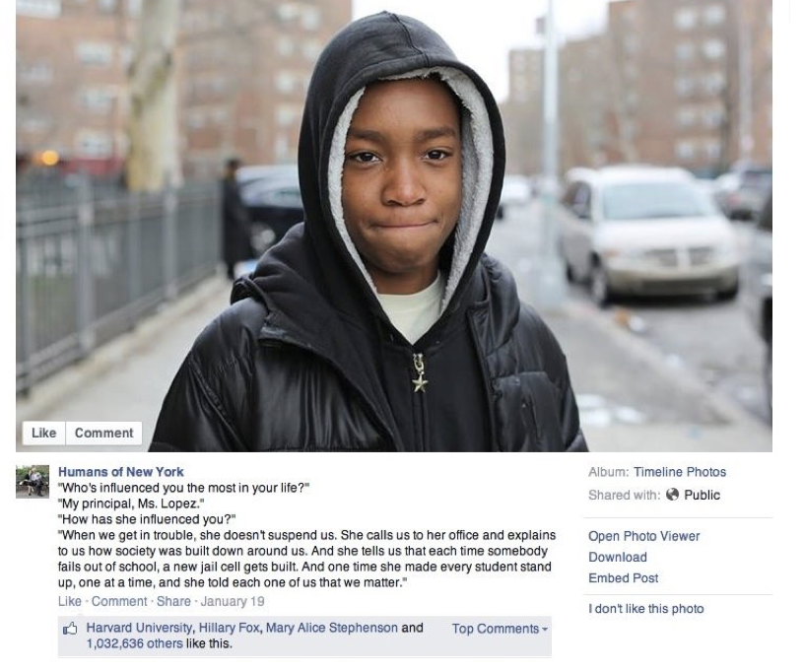

Slide 9
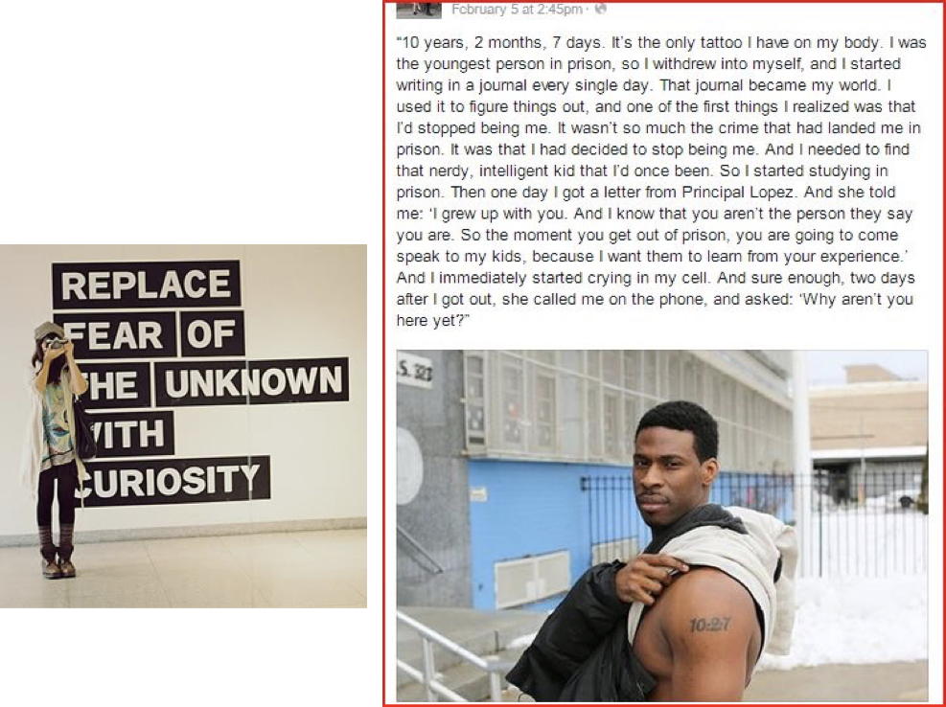

Slide 10
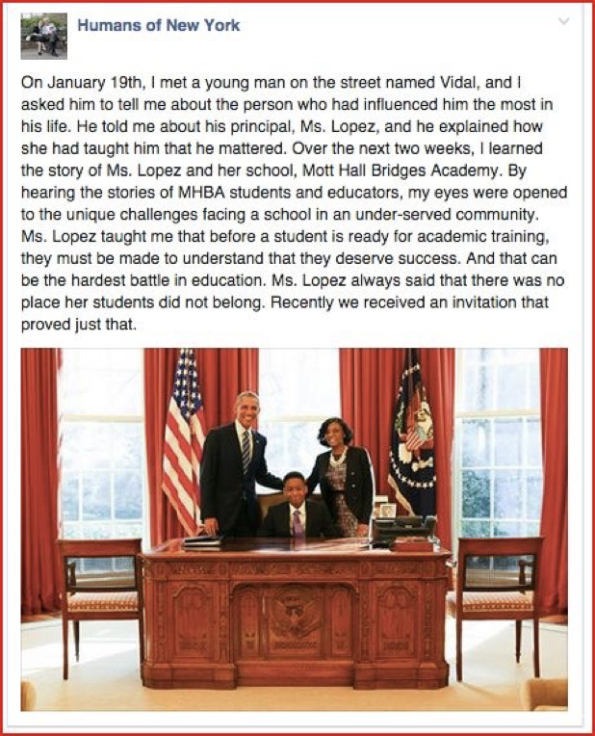

Slide 11
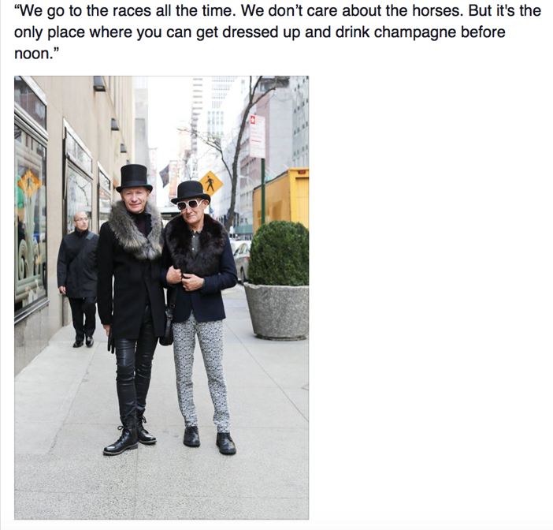
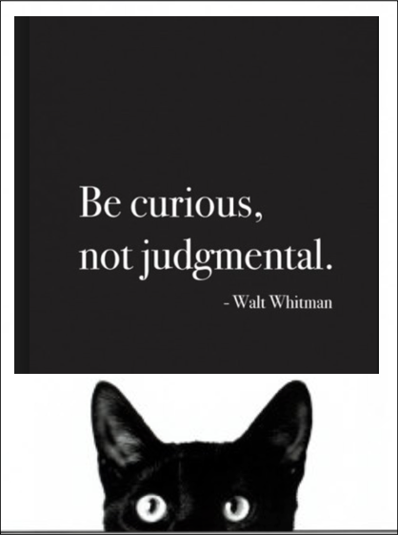

Slide 12
