Slide 1
Mistaken Identity
News Literacy

Slide 2
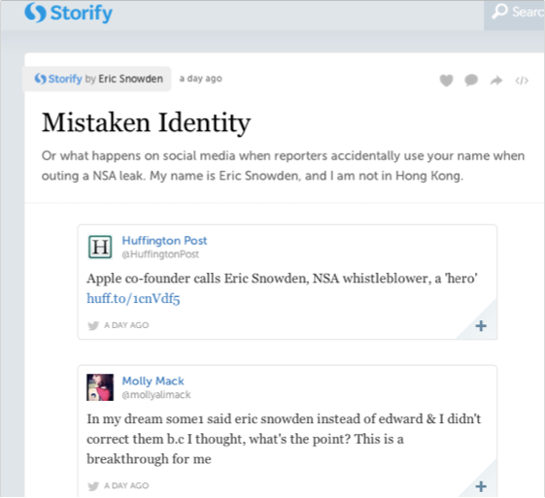

Slide 3
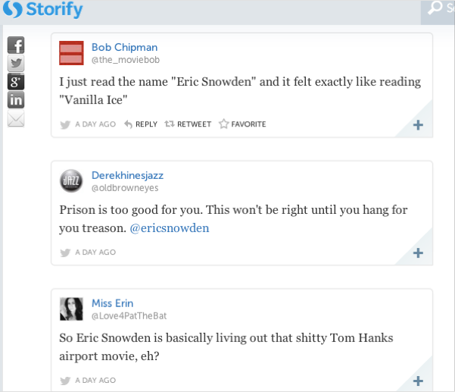
Notes:
Now, it’s getting serious. This man is essentially threatened with death, and it’s not the right guy!

Slide 4
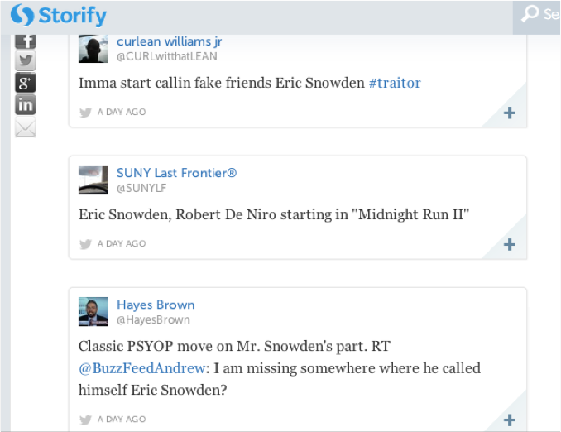

Slide 5
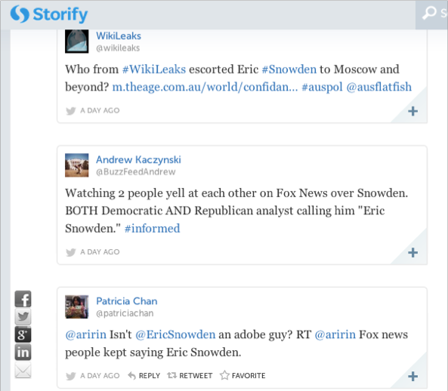
Notes:
Finally, someone got it right!

Slide 6
Types of sources

Slide 7
Expert sources
Example: professors, government agents
People whose business it is to know certain information. By experience or education, they have a wealth of knowledge of a given topic.
Have they kept up their education on the topic?
Do they demonstrate wide and deep knowledge?
Do others recognize them as experts in the field?

Slide 8
Official sources
Example: police officers, teachers, coaches
People who are in charge, whose titles or job functions directly link them to the information
Is this the right official, or is there someone with a closer link to the information?
How does this official fit into the story?
Do related officials recognize their authority?

Slide 9
Sources of interest
Example: family member of criminal, etc
People whose lives are directly affected by the topic. They are closely related to what’s going on because they might be the subject or cause of the topic.
How do we know these sources don’t have ulterior motives?
Do other sources trust them?
Which side of the story do they tell? What sides do they leave out?

Slide 10
Evaluating sources
The Poynter Institute, a think-tank that helps journalists be more thoughtful, accurate, and engaging, has tips on how to evaluate sources.
Notes:
These tips are paraphrased questions or directives from an article by Bob Steele.

Slide 11
Tips from Bob Steele at Poynter
Always ask: how does the source know what he/she knows?
Consider how you could prove what the source knows through records or other sources.
Ask what assumptions the source is making, and question those assumptions.
Ask yourself who else might know this information.

Slide 12
Tips from Bob Steele at Poynter
5. Ask whether this source has proven reliable in the past
or is referenced by other media.
6. Does the source have any motive for providing this
information? How does this information make the
source look?
7. Could the average citizen contact this source to find out
more?

