Slide 1
Beyond
the Snore
News Writing

Slide 2
Beyond the snore
Any event, idea, issue, press release, announcement, calendar listing has the potential to move beyond the obvious.
How can you cover news that seems routine in a way that is not routine?
Use the ideas presented here to test your next news story for a fresh angle or enterprise opportunity.

Slide 3
Some basic story types
snapshot of a moment
observation
personality profile
news-based feature
creative approach
But we’re talking about news that happens routinely and some things that repeat every year … how can you approach these topics in different ways so you don’t just write the same old thing?

Slide 4
The routine
It’s homecoming. What story will you write?
Notes:
Let the students discuss.

Slide 5
Eight ways to go beyond the obvious
issue or trend
explanatory
profile
voices
descriptive
investigative
narrative
visual
* As presented by Jacqui Banaszynski, Knight Chair in Journalism, University of Missouri, and former managing editor of The Seattle Times, as “Seven Paths (and an 8th Way) to Story”

Slide 6
1. Issue or trend
Does the event tie in to something people are talking about that’s bigger and more ongoing?
• Trends are generally lighter, related to culture.
• Issues are more serious, about social problems or policies.
For example: THE HOMECOMING DANCE
Trend: What’s the new dance everyone will be doing?
Issues: Will twerking be banned?
Growing use of the club drug MDMA – Will students try to use it before or during the dance?

Slide 7
2. Explanatory
Can you show how something happens orhow it works?
What’s the purpose or history of homecoming?
How did your school’s traditions get started?
What preparation is required to build a float, plan the dance, create the ceremony?
Who decides and how do they decide which game is the homecoming game?

Slide 8
3. Profile
Who is at the center of this event?
• Is there someone who is more affected by this than others? Why?
• Is there a place or a thing that is associated particularly with this event?
Can you offer some examples related to homecoming?
Who could you profile?
Notes:
Have students offer examples here. Usually this is pretty easy for them.

Slide 9
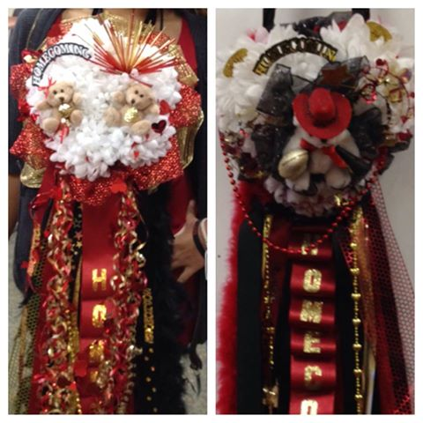
Here’s an example
In Texas, girls wear these for homecoming. The flower part of these things is 9.5 inches in diameter.
Photos by Cyndi Lemke, journalism teacher, Porter High School
Notes:
The point is that artifacts of homecoming can be the thing that provides a profile. It doesn’t have to be a person. They should push beyond just profiling the Homecoming Queen, unless there is something usual about her, such as she’s transgender or a refugee …

Slide 10
Profiles can be
a person or group at the center of the event or issue
an artifact or unusual item at the center of the event or issue
a place or activity that defines the eventor issue
… so don’t just think of people
Notes:
What defines Homecoming at your school?

Slide 11
Voices
Similar to a profile, but with this, you are looking for people who are more experts, who can speak about the subject in a different way.
How about a quote box from alumni about their best homecoming memory?
Think about who is affected and what they might have to say.

Slide 12
5. Descriptive
Can you show or describe a person or place that’s uniquely associated with your event?
Can you take your readers somewhere they would never think to go?
the locker room before the football game
the planning and preparation of the group that always has the most elaborate hall decorations
the room and the process of counting votes for homecoming king/queen

Slide 13
6. Investigative
Follow the money, the power, the self-interest.
• Is there anything wrong with this picture? • There might not be, but even if there isn’t, wouldn’t you like to know who gets the money? Where does it go?
How much does the homecoming game cost the school? (Extra police, stadium rental, sashes and car rentals for the homecoming court, what else?)

Slide 14
7. Narrative
Is there a story to tell behind the event?
Don’t get stuck trying to tell the entire story from beginning to middle to end. Look for narrative elements:
a main character
conflict or tension
action and momentum
resolution
What story do you have about homecoming?
Notes:
Another one to get the students’ involved. What stories do they have?

Slide 15
8. Visual
Maybe it’s not a story at all. Is there a way to tell the story with few words?
a photo essay
a chart or graphic
a timeline
a map
some other visual device?
Notes:
Get more ideas from the students

Slide 16
Beyond the snore
EVERY story,
long or short,
in-depth or quick turn,
NEEDS AN ANGLE.
What’s yours?

Slide 17
Find your angles
Meet in groups of three. Choose a team leader, scribe and presenter.
First, choose one topic or event that’s news every year. (prom, homecoming, Valentine’s Day, talent show, school play, blood drive, etc.)
Each group member should quickly and quietly write down five possible angles on that topic, using any of the story paths.
One by one, share your angles with your group. The scribe makes notes while the team leader makes sure everyone participates.

Slide 18
Find your angles
The group must work together to help each member choose the best angle to pursue, so that each group has three solid story ideas for their topic.
Next, brainstorm ideas about who you need to interview or how you would get info for the story.

Slide 19
Presentations
Each group must:
present the topic or event they brainstormed
list at least three different stories on that topic
explain which of the eight story paths they chose and why
suggest where they will get the information to complete the stories (what research is necessary and who will they interview)

