Slide 1
Works In Progress
Photojournalism
Notes:
*

Slide 2
Sometimes the best ideas don’t quite turn out as imagined.
The key is to keep on shooting, keep on practicing.
(All photos courtesy of McKinney High School Publications)

Slide 3
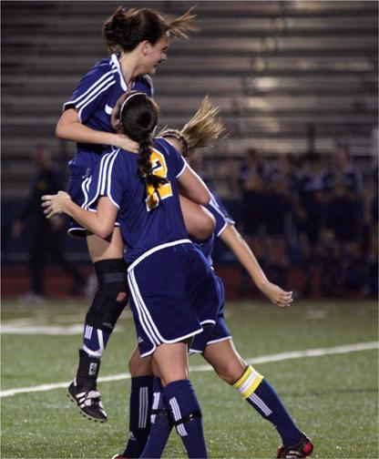
Notes:
*

Slide 4
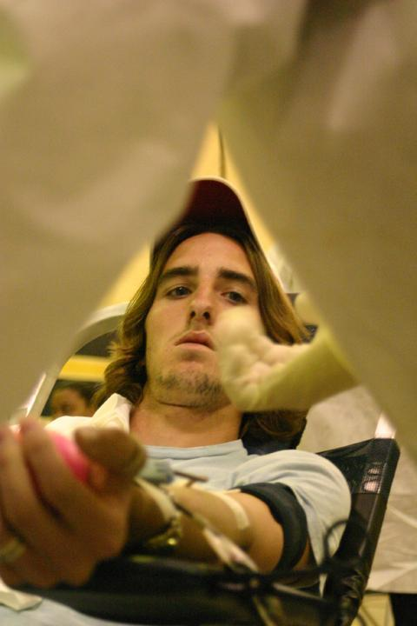
Notes:
*

Slide 5
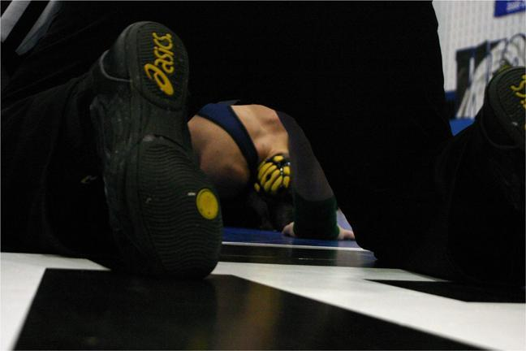
Notes:
*

Slide 6
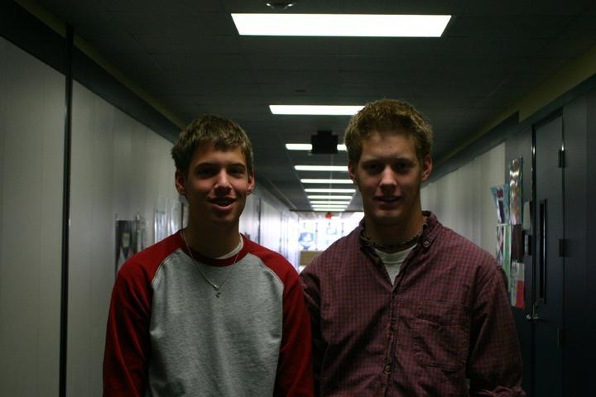
Notes:
*

Slide 7
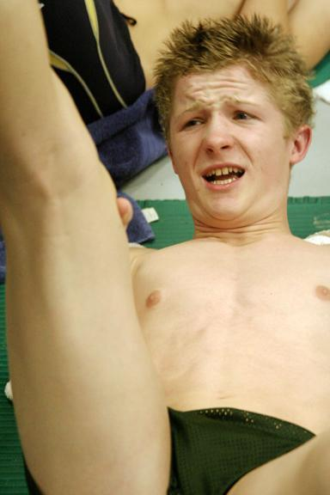
Notes:
*

Slide 8
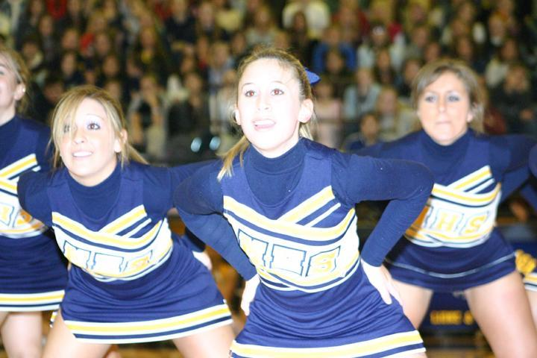
Notes:
*

Slide 9
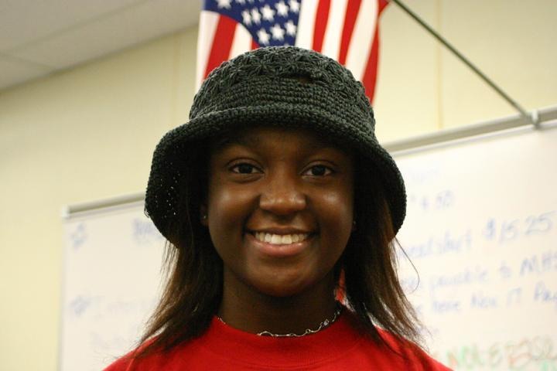
Notes:
*

Slide 10
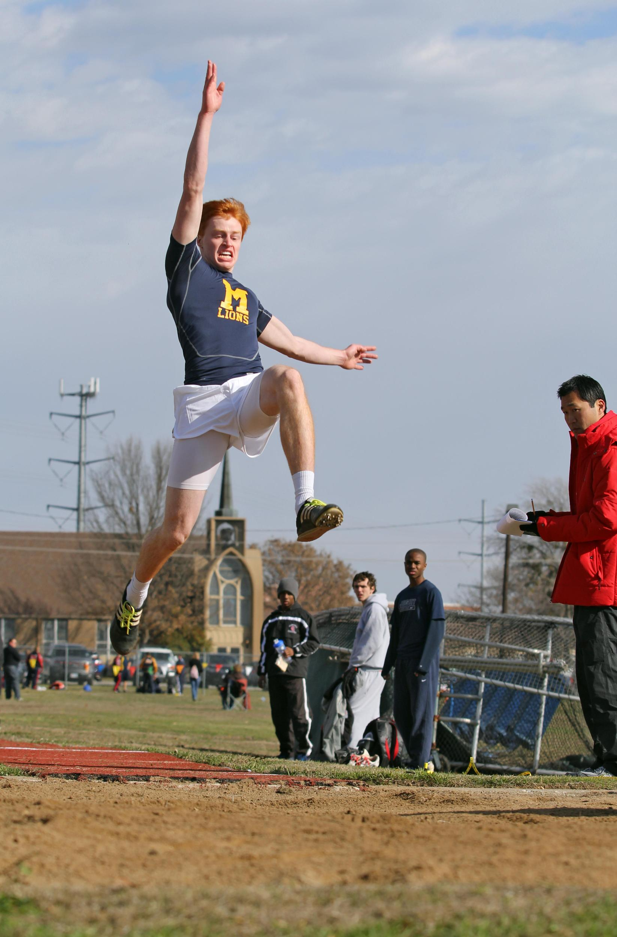
Notes:
*

Slide 11
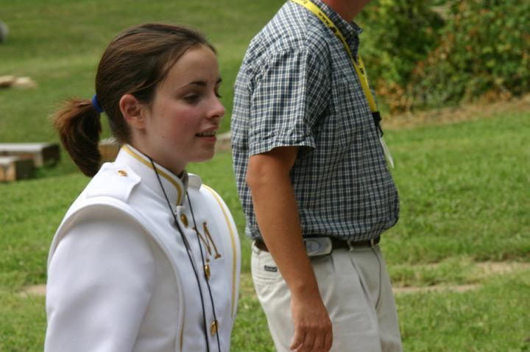
Notes:
*

Slide 12
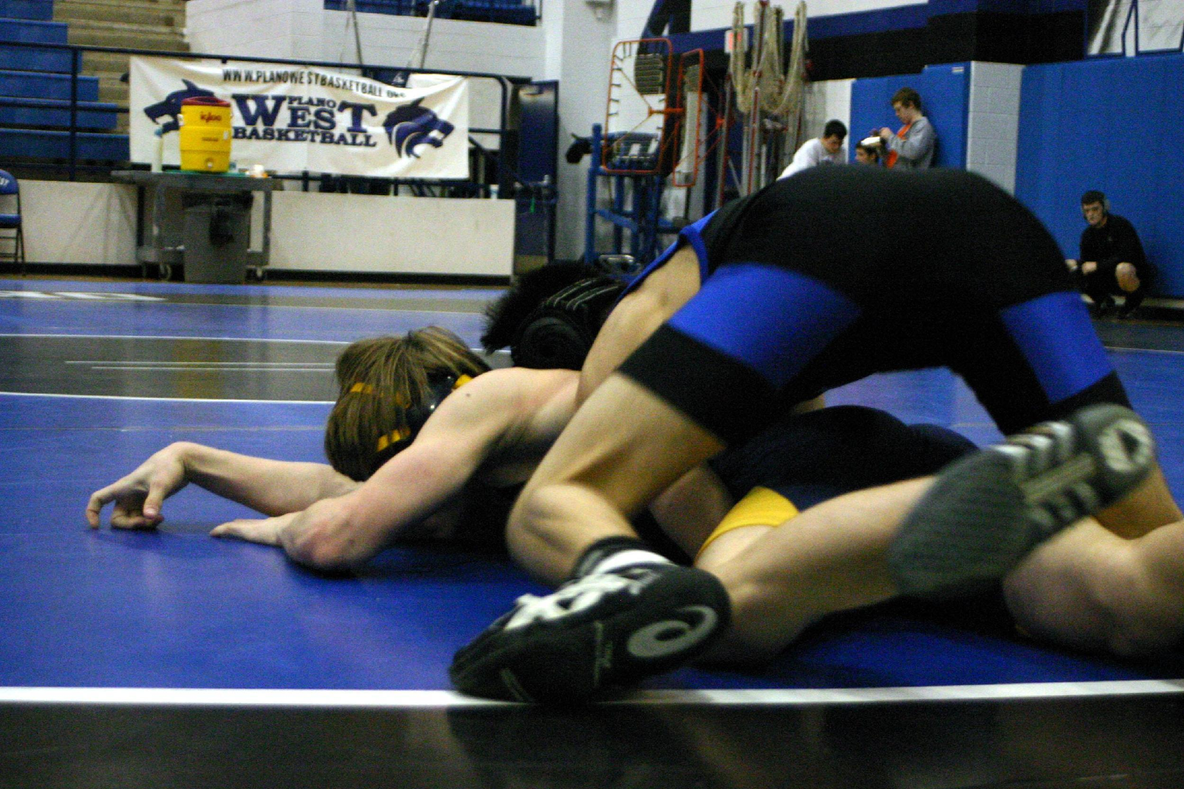
Notes:
*

Slide 13
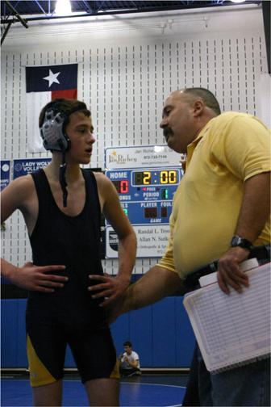
Notes:
*

Slide 14
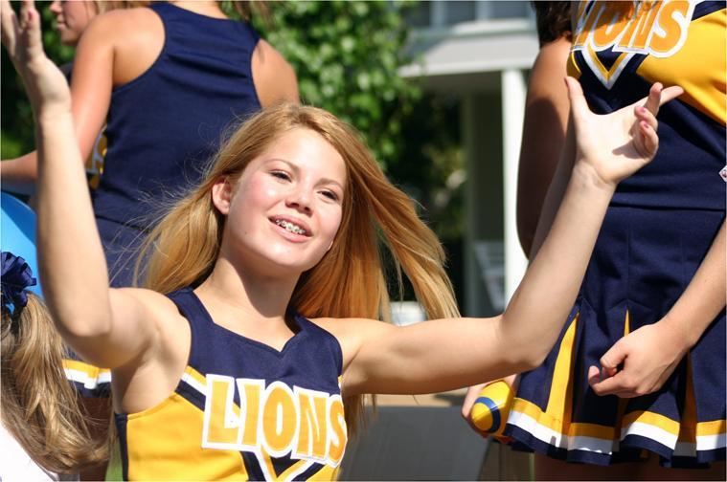
Notes:
*

Slide 15
Notes:
*

Slide 16
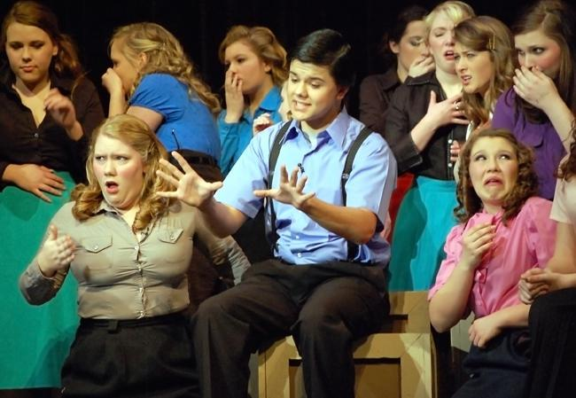
Notes:
*

