Slide 1
Going Live: Three Real-time
Coverage Options
Web

Slide 2
JFK assassinated
Home audiences watch as newscasters deliver news that President Kennedy was assassinated.
Notes:
Click to view via CBS Sunday Morning

Slide 3
Armstrong walks on moon
“Oh, thank you television for letting us watch this one!”
— former astronaut Wally Schirra, Jr., on July 20, 1969, after Neil Armstrong took his first step on the moon
Notes:
via CBS, actual landing moment at 1:55 in video

Slide 4
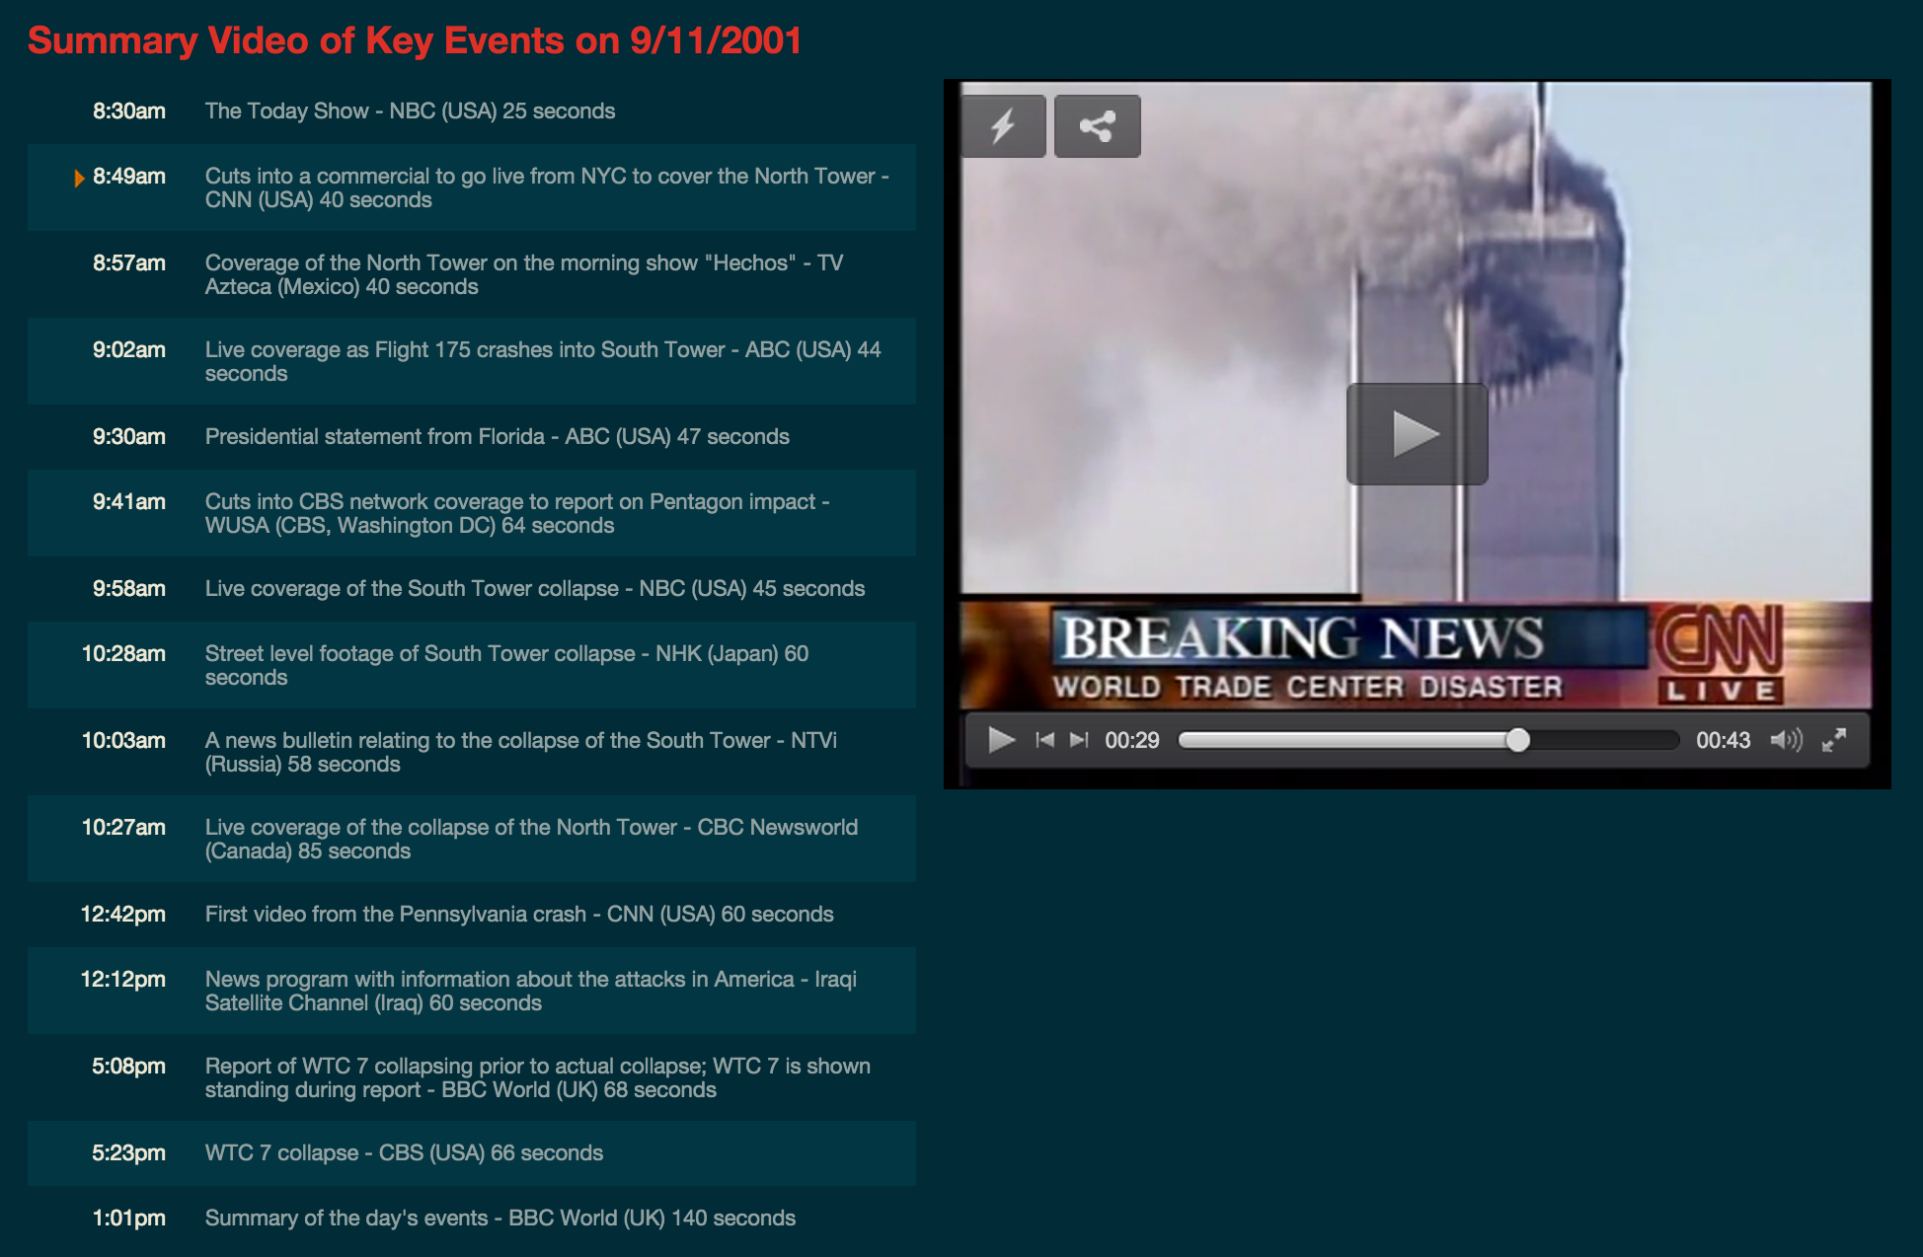
9/11
Terrorists attack World Trade Center
Notes:
Click image to visit archives site with news footage.

Slide 5
Quick Response
What do all three live news examples share in common? Do you notice any changes from the first (1963) to the third (2011)?
What does live coverage look like now, in an Internet age — when many people have Internet access from devices like smartphones and computers? What's different?

Slide 6
Live video — how to
Google Hangouts is one option (free)
Must be a visual story
Can range from a single handheld camera to a multi-camera shoot
Hangout video remains archived on YouTube after live broadcast

Slide 7
Live video — things to consider
Must be a visual story
Requires reliable broadband
Audience needs advance notice to "tune in"
Think about your audience and when they are available
Reporters must make real-time decisions about shots, etc

Slide 8
Live blogging — how to
ScribbleLive is one option (free)
Less visual but can integrate outside media
Can pull from public social media posts
Possible to prepare some posts in advance
Embed directly into post on site
Notes:
EXAMPLE: “'Doctor Who' Live Blog: The 12th Doctor Revealed” by Mashable
http://mashable.com/2013/08/04/doctor-who-live-blog-12th/

Slide 9
Live blogging — things to consider
Audience needs advance notice to "tune in" or can read transcript after
Updates can be made directly from a smartphone app
For event coverage, multiple reporters can contribute
Video and photos can be integrated as well
Audience gets to participate

Slide 10
Social media updates
Can use Twitter or Facebook
Reporting can become part of a larger conversation (national/international)
Easy to update with quick bursts of information
Free and relatively effortless
Notes:
EXAMPLE: “On the ground in Ferguson” by The L.A. Times
https://storify.com/latimes/on-the-ground-in-ferguson

Slide 11
Social media updates
Requires a device connected to Internet or a cellular network
Reporters need advance training beforehand to ensure professionalism of post content, style
Curation service like Storify could be used to present coverage directly in a post on the news website

Slide 12
Application
Other than breaking news, what might audiences like to know in real time?
Brainstorm three school-related live coverage ideas with a partner.

Slide 13
Application
Other than breaking news, what might audiences like to know in real time?
sports game plays, results
major announcements
political election results
others?

Slide 14
Choosing a live coverage solution
Is the coverage planned or unplanned, like a breaking news story?
What resources (including the number of trained reporters) are available to produce the coverage?
Is this a highly visual story?
Notes:
Keep this slide up as students complete the next activity.

