Slide 1
Creating GIFs using GIPHY
Web

Slide 2
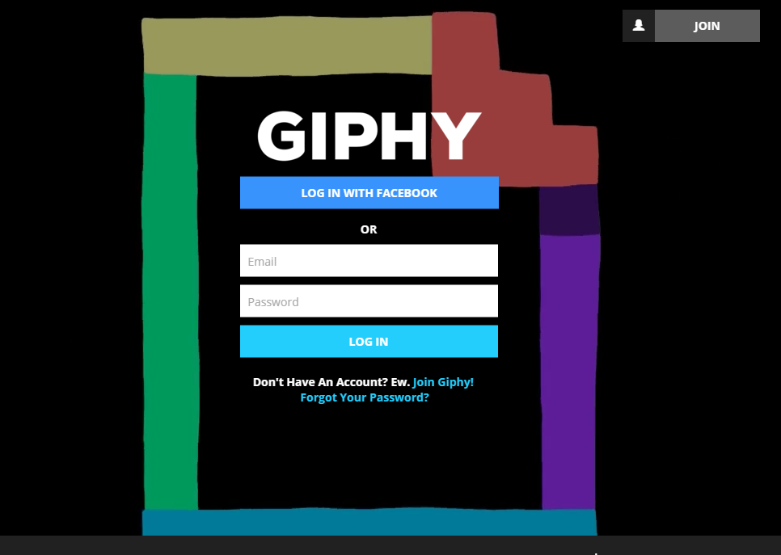
Create an account or log in
https://giphy.com/login

Slide 3
Select the option to upload

Slide 4
Make sure you have the sample video file...

Slide 5
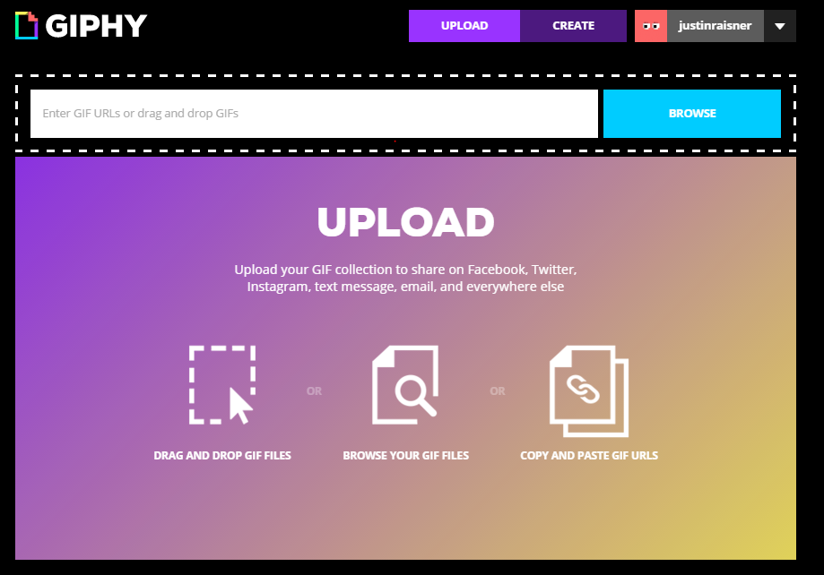
Click “Browse”

Slide 6
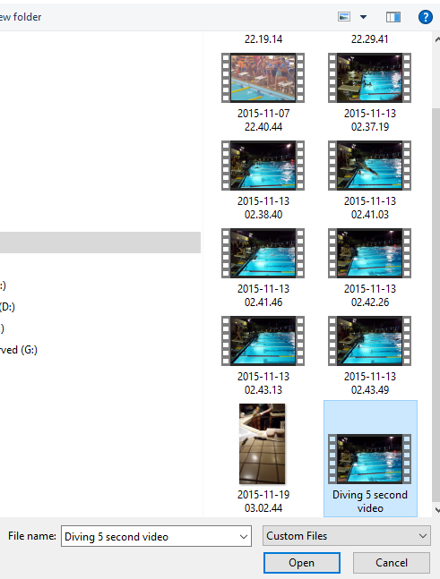
Upload your video file.
Select and open

Slide 7
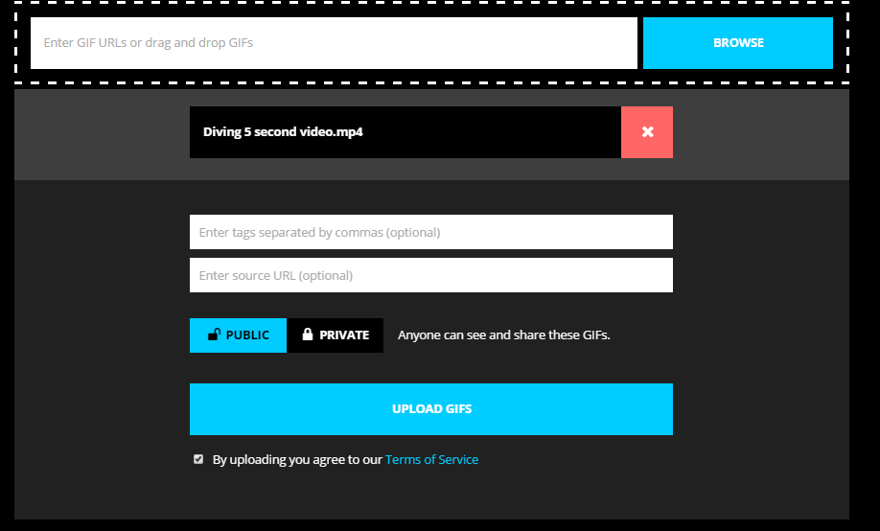

Slide 8
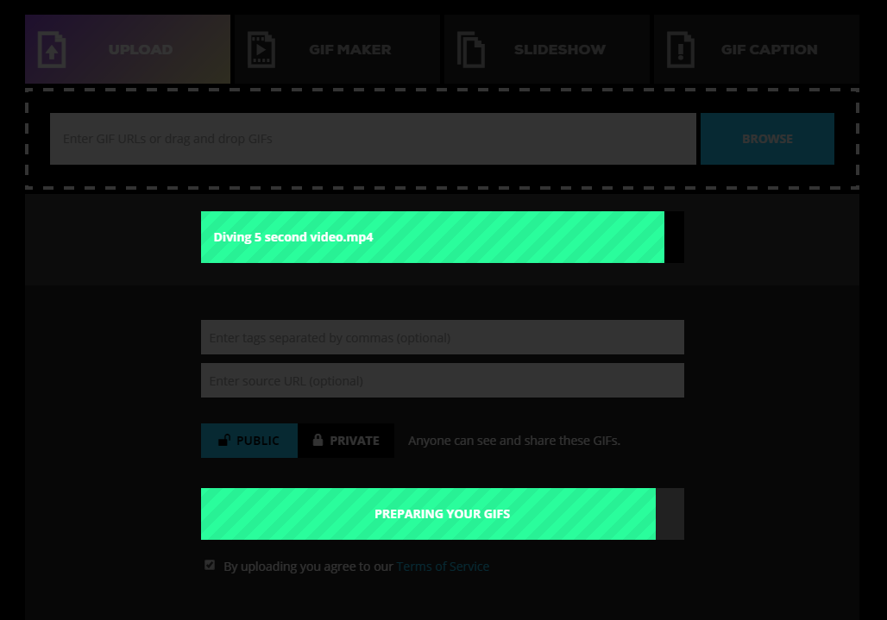
Wait for it to process ...

Slide 9
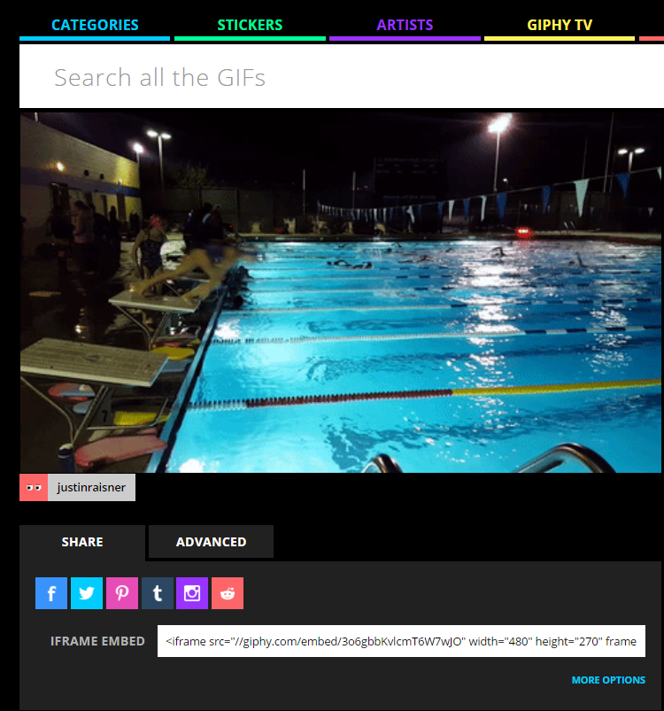
Copy the embed code
for posting online

Slide 10
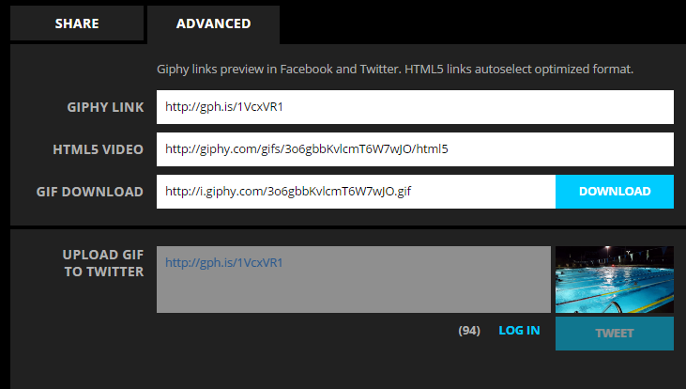
Under “Advanced” you can download or share on social media

Slide 11
Shoot your own short video
Guidelines:
Look for action.
Look for the subject doing the thing in the beat.
Look for emotion.
Limit clip to less than 15 seconds.

Slide 12
Create your own GIF
When you finish, submit the file for feedback.
Your next beat should include one GIF.

