Slide 1
Shooting
Cell Phone Video
Web

Slide 2
What is a video segment?
Broadcast segments serve as a visual and auditory medium through which news can be delivered.
Each video typically spans from 1:00 to 4 minutes, depending on the story.
Includes interviews, B-roll, voiceovers, and post-production editing.
Utilizes video and audio to tell a story

Slide 3
Options for cell phone video...
A series of interviews stitched together
A series of clips narrated by the reporter
(available cell phone apps for editing are not very dynamic for blending the two)

Slide 4
Picking a Topic
Because the news is delivered in broadcast form, it’s important that the story lends itself well to the medium.
When choosing a topic to cover, always make sure that there will be compelling visuals, as well as some amount of natural audio.

Slide 5
Checking in - tell the person next to you...
What kind of stories would be best complemented by a quick cell phone video?

Slide 6
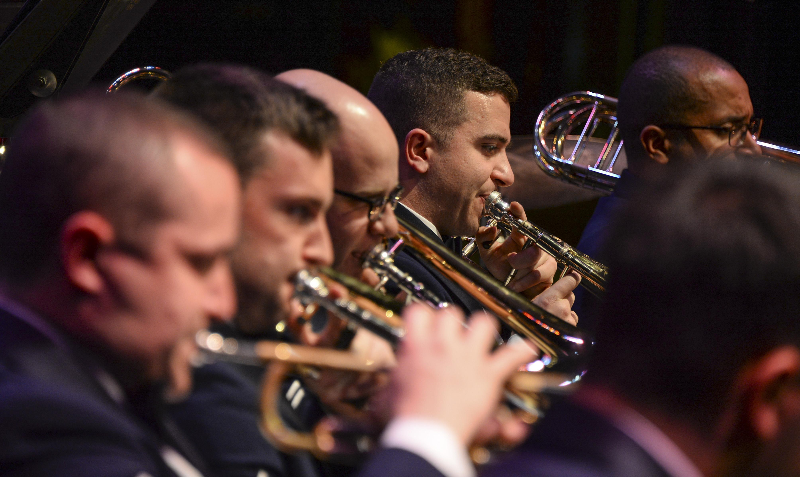
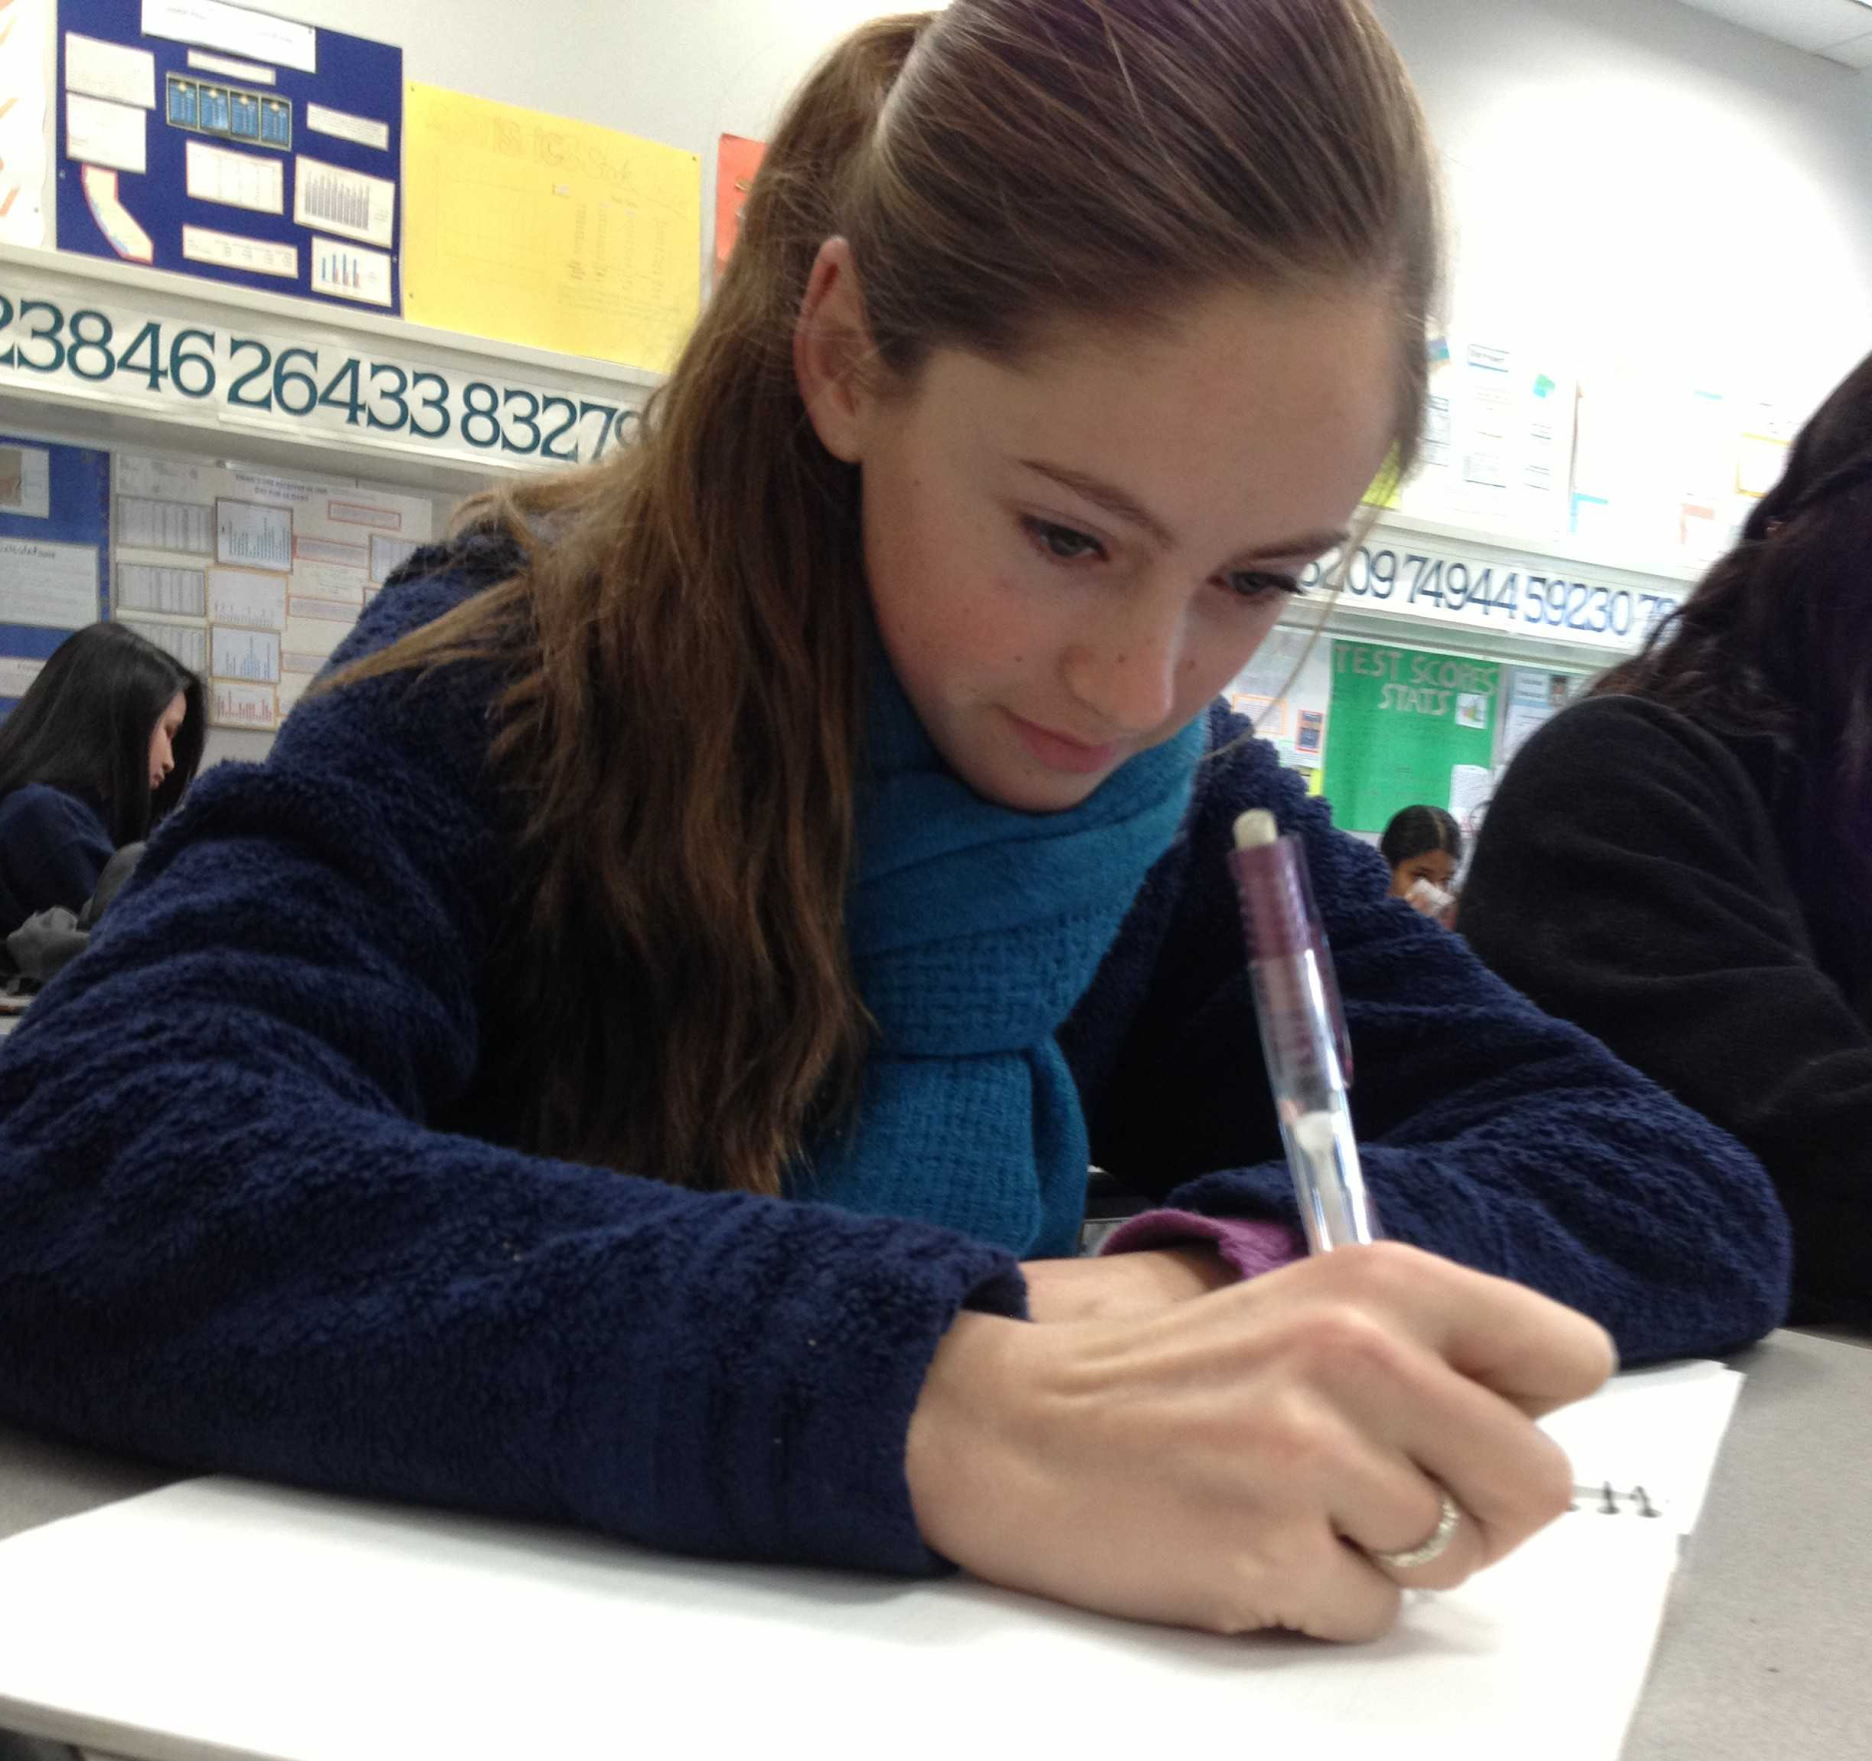
Picking a Topic
Good - a local concert. Relates to the school, videographer can get great, dynamic visuals of the performers and audience, lends itself well to NAT sound.
Bad - new school-wide testing. Visuals are bland and static, audio is practically nonexistent. Although it could be a good story, it won’t make for a very interesting video.
(U.S. Air Force photo by Airman 1st Class Mya M. Crosby/Released)
(Photo by Shira Stein / Scot Scoop News / used with permission)

Slide 7
Preparation - gear needs
Mic - for interviews, a clip on lavalier mic works best. Make sure the interviewee puts the cord under their shirt, so it doesn’t show.
If you can’t - be very aware of ambient noise

Slide 8
Set up
When shooting, get approximately 5 seconds of silent noise at the beginning and end of the interview (you will probably cut this later).

Slide 9
Set up
Tripod - use a tripod for interviews. It doesn’t have to be fancy, just something that works.
If you can’t - make sure to balance the camera so it isn’t bobbing or shaking.

Slide 10
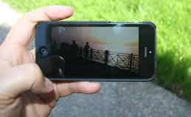
Set up
ALWAYS hold the camera HORIZONTALLY
(Scot Scoop News / used with permission)

Slide 11
Checking in - tell the person next to you...
How should you hold the camera?
What’s an important tip to remember about audio?

Slide 12
Lighting
Always make sure the light is behind the CAMERA, not your SUBJECT (person or thing.)
Never shoot directly into bright light.

Slide 13
Lighting
Easy ways to manipulate lighting:
Move lamps or other light sources closer to your subject
Open or close blinds
Move either the subject or camera
Shoot in shade instead of directly under sun

Slide 14
Checking in - tell the person next to you...
What is one LIGHTING tip to know?

Slide 15
Interviews
Rule of thirds - subject should be on the rule of thirds line.
Both the camera and interviewer should be at eye level of the subject (either of the upper blue dots)
Subject should be looking across the screen, and NEVER directly at the camera
*Note - background of the interview should have depth

Slide 16
Interviews
Setting - interviews should be conducted in the subject’s natural environment.
Check lighting and background noise before conducting interview
If the natural setting doesn’t lend itself well to the interview, place subject in front of a basic background (but not up against a wall!)

Slide 17
Interviews
An option if to have a person talking while doing something.
If a person is reviewing a food tour…
Person could be recorded walking from place to place.
Person could be recorded eating food
Person could be recorded describing the setting.
Stitch those all together and you have a video.

Slide 18
Interviews
Always write down the correct spelling of the subject’s name and their position or title
(get contact info for follow up!)

Slide 19
Interviews - be aware of the following
These mistakes will ruin your video:
Bad audio
Shaky video
Poorly lit video
Too much panning and zooming

Slide 20
Checking in - tell the person next to you...
What is important for doing interviews?

Slide 21
B-roll
B-roll is the footage that goes over audio.
It should relate to the topic, and correspond with what the subject is talking about.
You can never shoot too much B-roll!

Slide 22
B-roll
Use this style if you plan to narrate audio and lay clips on top of it.
If a person is reviewing a food tour…
Get several shots of food, locations, and people moving/walking/doing.
Afterwards, create an audio file that will be the backbone of the story - place the clips together to watch while hearing the narration

Slide 23
B-roll
This may be a better choice if you are working alone or the ambient noise does not lend itself to conducting interviews
Shots should tell a story - they should flow together and relate to what is being said on the voice over
Footage should always be stable, and audio should be good quality

Slide 24
B-roll
Don’t be afraid to get in someone’s face or get in an awkward or strange position to get the shot you want
Anticipate where the action will be, and set up the shot BEFORE it happens

Slide 25
B-roll
In this clip, the b-roll works to give a visual that aligns with what the subject is describing.
Scot Scoop News

Slide 26
B-roll
It’s important to get a wide variety of shots - in addition to different images, there should also be a combination of wide, medium, and close ups.

Slide 27
Checking in - tell the person next to you...
What is B-Roll and when do you use it?

Slide 28
Types of Shots - WALLDO
WALLDO stands for WIDE/ANGLED/LOW/LINKING/DEPTH/OPPOSITE.
It is a mental cheat-sheet for shooting video in the field. The shots are creative but also have very practical purposes behind them.
(The source of this is Dave Davis in a blog for the Academy of Scholastic Broadcasting)

Slide 29
Types of Shots - WIDE
Shooting from a distance provides context, and perspective. It shows the viewer the big picture, and establishes location.
Scot Scoop News

Slide 30
Types of Shots - ANGLED
When you shoot everything from directly in front, it takes away depth and also seems safe, and sometimes bland.
Shooting things like buildings, and especially signs from an angle makes for a more interesting visual.
Scot Scoop News

Slide 31
Types of Shots - LOW
Shooting from ground level, or even knee-level, gives viewers a different perspective.
Put the camera on the ground to get the feet passing by during passing period.
Scot Scoop News

Slide 32
Types of Shots - LINKING
This requires movement of the camera.
It is a shot that links two related objects or subjects by panning from one to the other.
Maybe you follow a jogger running to your left, and as she passes by the "Relay for Life" sign, you stop on the sign.
You have now "linked" the participant with the cause.

Slide 33
Types of Shots - DEPTH
Find foreground objects to put in your frame when you shoot. They allow you to add depth to the visuals.
Scot Scoop News

Slide 34
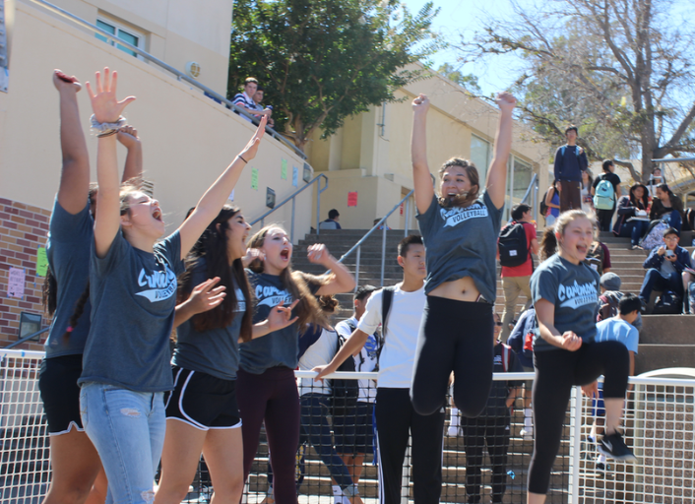
Types of Shots - OPPOSITE
This is the reverse angle in video, or the "reaction" shot. The opposite of the running back scoring a touchdown is the shot you get when you turn around and show the cheering crowd.
Scot Scoop News

Slide 35
Checking in - tell the person next to you...
What are all the WALLDO elements?

Slide 36
Recording your narration
A broadcast video typically begins with an intro (lede) delivered by the reporter.
This can either be a voiceover with B-roll, or a professional shot of the reporter.

Slide 37
Recording your narration
If the reporter is visible, they should be dressed appropriately, centered on the rule of thirds, and either reading from a teleprompter or have the intro memorized.

Slide 38
Recording your narration
Intro should capture the viewer’s attention, and give a brief description of the topic (same purpose as a lede).

Slide 39
Recording your narration
Outro: Wraps up the story, provides the “Now what” or “Why does this matter” (kicker)
Can either be a voiceover or a shot of the reporter
Optional: conclude with
“Reporting for _____, I’m _______”

Slide 40
Post Production Editing
Editing the video is what brings the whole thing together - it’s extremely important that your broadcast segment is well-edited.

Slide 41
Adobe Premiere Clip Video
Adobe.com

Slide 42
Post Production Editing
Steps for editing a broadcast video:
Create new event in editing app
Import all footage into the event
Go through interviews, cut what you like and put it into timeline (doesn’t have to be in order yet)
Set up the AUDIO as the backbone

Slide 43
Post Production Editing
Begin sorting through B-roll, and drag clips over audio
B-roll should be around 3-5 seconds long
Visuals should relate to what is being said

Slide 44
Post Production Editing
Once you have all the B-roll placed and everything is in the correct order, go through the interviews and B-roll and make sure all the cuts are clean
Select all B-roll, and lower the volume to 10% (leaves a bit of NAT sound)

Slide 45
Uploading and Publishing
Watch through video at least twice, and fix any errors

Slide 46
Uploading and Publishing (tips)
Upload to YouTube (or other domain)
Give it a headline
Write a brief description
Ex: (Reporter name) reports on (event)
Select a custom thumbnail
Thumbnail should be the best still from the video, and should be representative of the topic
Disable comments on video
Publish!

Slide 47
General Tips
Always double check all equipment before going out to shoot
It’s okay to ask someone to move out of the way of a shot, or request that a subject repeat something in an interview
Pay attention to lighting and background audio
Video should be published shortly after event (the whole video can be shot, edited, and published in one day if done correctly)

Slide 48
Other Online Editing Apps
Adobe Premiere Clip (free for Android and iOS)
Videoshop (free for Android)
VQuick (free for iOS and Android (but you have to pay for the good stuff)
iMovie (free for iOS)
WeVideo (free but very limited)

