Slide 1
Fair Use
in the Era
of Social Media
Web

Slide 2
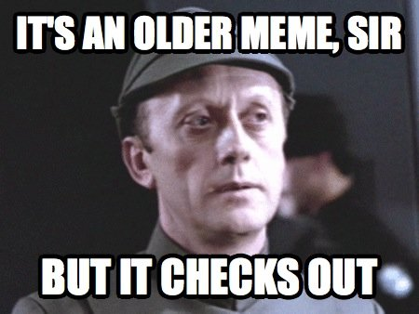
We see these all the time on social media

Slide 3
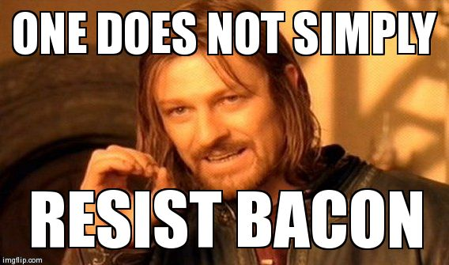
We see these all the time on social media

Slide 4
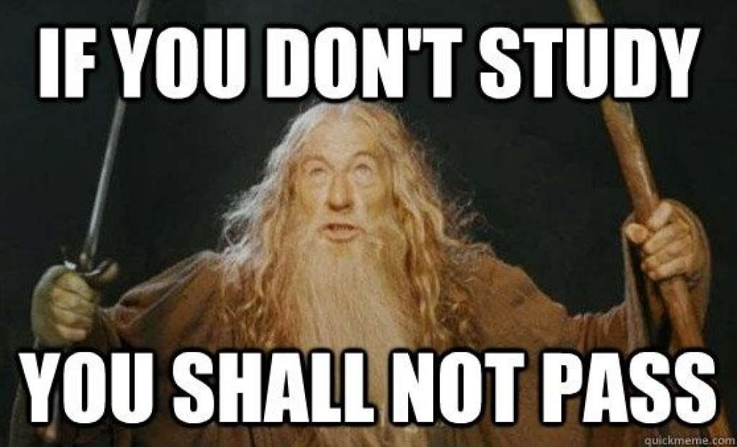
We see these all the time on Social Media

Slide 5
Aren’t these images protected by copyright?
Could you be sued for using them?
Could you be sued for reposting them?

Slide 6
Today’s discussion
will address that ...
Objectives
Students will gain a deeper understanding of fair use.
Students will be able to articulate instances in which something on social media can be used.
Students will be able to make proper ethical decisions about re-using other people’s work.

Slide 7
Courts consider the following:
The purpose and character of the use, including whether such use is of a commercial nature or is for nonprofit educational purposes;

Slide 8
Courts consider the following:
The nature of the copyrighted work;

Slide 9
Courts consider the following:
The amount and substantiality of the portion used in relation to the copyrighted work as a whole;

Slide 10
Courts consider the following:
The effect of the use upon the potential market for or value of the copyrighted work.

Slide 11
As you see the following examples ...
In small groups discuss:
The purpose and character of the use
The nature of the copyrighted work The amount and substantiality
The effect of the use upon the value
Be prepared to share with the class.

Slide 12
Case 1
Daniel Morel took photographs of the 2010 earthquake in Haiti that Agence France Presse obtained from the Twitter feed of a third party and distributed without Morel’s permission.
AFP brought a suit seeking a ruling that it had not violated Morel’s copyright claiming AFP should be protected by Twitter’s terms of service which allow Twitter “to make your Tweets available to the rest of the world and to let others do the same.”
(Use your phone to review Twitter’s terms of service yourself.)

Slide 13
Review ...
In small groups discuss:
The purpose and character of the use
The nature of the copyrighted work The amount and substantiality
The effect of the use upon the value
Be prepared to share with the class.

Slide 14
Case 1 result
AFP, however, underestimated the importance of the next sentence: “But what’s yours is yours – you own your content.”
Morel countersued for copyright infringement.
The court ruled in Morel’s favor, holding that Twitter’s terms of service do not permit third parties to remove content from Twitter to post elsewhere.
A jury found the infringement to be willful, awarding Morel $1.2 million in statutory damages, the maximum possible statutory award.
There is no blanket right to copy others’ works, even if properly attributed.

Slide 15
Case 2
North Jersey Media Group owns the famous photograph of firemen raising a flag above Ground Zero in the hours after the September 11, 2001 attacks.
On the 12th anniversary of the attacks, a Fox show, “Justice with Judge Jeanine,” posted a slightly altered version of the photograph to Facebook.
NJMG sued and Fox sought a ruling that its reproduction of the photograph, alongside the 1945 Iwo Jima flag raising, with the caption “#NeverForget,” was fair use because it conveyed a message.

Slide 16
Review ...
In small groups discuss:
The purpose and character of the use
The nature of the copyrighted work The amount and substantiality
The effect of the use upon the value
Be prepared to share with the class.

Slide 17
Case 2 result
Nonetheless, the court found that Fox’s alteration of the content and message of the photograph was “minimal,” and did not constitute an original idea.
To the extent Fox’s use of the image could be considered commentary, the judge held that it “merely amounted to exclaiming ‘Me too.’” In holding that Fox’s use had at least the potential to damage NJMG’s market for the work the judge quoted the Supreme Court’s holding that this factor was “undoubtedly the single most important element of fair use.”

Slide 18
Case 2 result
The court’s denial of Fox’s fair use defense provides useful guidance to others.
Had the Facebook post discussed the photograph itself, or if it was directly related to the content, then the analysis might have looked different.
But the strongest takeaway from this case is that merely posting a copyrighted work to social media as part of a conversation is not “transformative” enough for fair use protection.

Slide 19
Case 3
Richard Prince is a well-known “appropriation artist” who makes changes to other’s works, claiming that the new work is distinct and protected by fair use.
Prince took photographs from Instagram without permission and turned them into gallery pieces by enlarging them and adding an Instagram-style frame with new captions/comments, as you might find on Instagram.
Prince displayed these works at the Gagosian Gallery in New York and sold them for upwards of $100,000.

Slide 20
Case 3
One of the photographers whose work Prince appropriated, Donald Graham, sued for copyright infringement in late 2015.
Similar to the Morel case, Graham’s photo had been posted to Instagram by a third party without authorization and Prince took it from that post.
(Use your phone to review Instagram’s terms of service yourself.)

Slide 21
Review ...
In small groups discuss:
The purpose and character of the use
The nature of the copyrighted work The amount and substantiality
The effect of the use upon the value
Be prepared to share with the class.

Slide 22
Case 3 ...
As of June 2016, the case is still in court, so we don’t know.
Discuss:
What should journalists and editors consider regarding these cases and fair use?

Slide 23
Takeaways ...
But both the case law and trends are clear that copyright is very much alive online and that stating “it’s just Facebook/Twitter/Instagram” is not a legal defense to infringement.
Media organizations should be especially wary of using content they cannot confidently source and license.

Slide 24
Assessment/homework
Research, think, write.
Your assignment is a two-paragraph response.

