Slide 1
Stylesheets and Coding
Web

Slide 2
Cascading Style Sheets (CSS)
Also referred to as “style sheets.”
CSS separates the presentation of an HTML document from the actual content (text) on the page.
Styles such as text size, color, and format are defined and applied across multiple pages on a website and can be updated globally using the particular style.

Slide 3
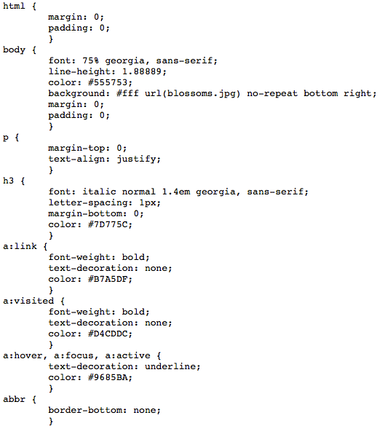
Sample CSS
On the right is sample CSS code from http://www.csszengarden.com
By examining the CSS code, you can see how after each key word is a set of design elements that are being addressed.
After html, a bracket { follows and then lines of code. The second bracket is a closing }
The style specifically ends for html after the closing bracket.
css released under Creative Commons License - http://creativecommons.org/licenses/by-nc-sa/1.0/

Slide 4
Sample CSS
Each line of code represents something specific, which will be affected by the code.
For the body code, the CSS is identifying what the font size is: 75% and also the font name: Georgia, a sans serif font.
Line-height identifies the spacing, which is followed by the hex color: #555753 or a dark grey
Students can find out color codes at: http://www.color-hex.com
css released under Creative Commons License - http://creativecommons.org/licenses/by-nc-sa/1.0/

Slide 5
Sample CSS
The background #fff is black and a photo (blossoms.jpg) is loaded, without tiling (no repeat) and it is aligned to the bottom right; with no margin and no padding.
Download the CSS code from http://www.csszengarden.com and dissect the rest of the code.
Utilize the website as a resource to see if what you think rings true for each lines of code.
css released under Creative Commons License - http://creativecommons.org/licenses/by-nc-sa/1.0/

Slide 6
The Beauty of CSS Design
Next, download the HTML code from: http://www.csszengarden.com
This document lists ways that students can experiment with CSS code:
Below is text pulled from the HTML document from the CSS Zen Garden. The website was created to allow you to play with CSS code and see how it affects the style of the HTML document:
CSS Zen Garden
The Beauty of CSS Design
A demonstration of what can be accomplished through CSS-based design. Select any style sheet from the list to load it into this page.
Download the example html file and css file
The Road to Enlightenment
Littering a dark and dreary road lay the past relics of browser-specific tags, incompatible DOMs, broken CSS support, and abandoned browsers.
We must clear the mind of the past. Web enlightenment has been achieved thanks to the tireless efforts of folk like the W3C, WaSP, and the major browser creators.
The CSS Zen Garden invites you to relax and meditate on the important lessons of the masters. Begin to see with clarity. Learn to use the time-honored techniques in new and invigorating fashion. Become one with the web.

