Slide 1
Using analytics to drive traffic
Web

Slide 2
Options within analytics
In the Google report interface, you can select different reports to review

Slide 3
COMPARE DATES
This week versus last week
This month versus last month
The past 30 days versus the same 30 day period 1 year ago
Notes:
Comparing dates lets you check your website’s traffic against another time period. On the very top right side of the Google Analytics dashboard, you can select your desired date range and select the date range to compare it to. This function allows you to see the progress of your site over time.

Slide 4
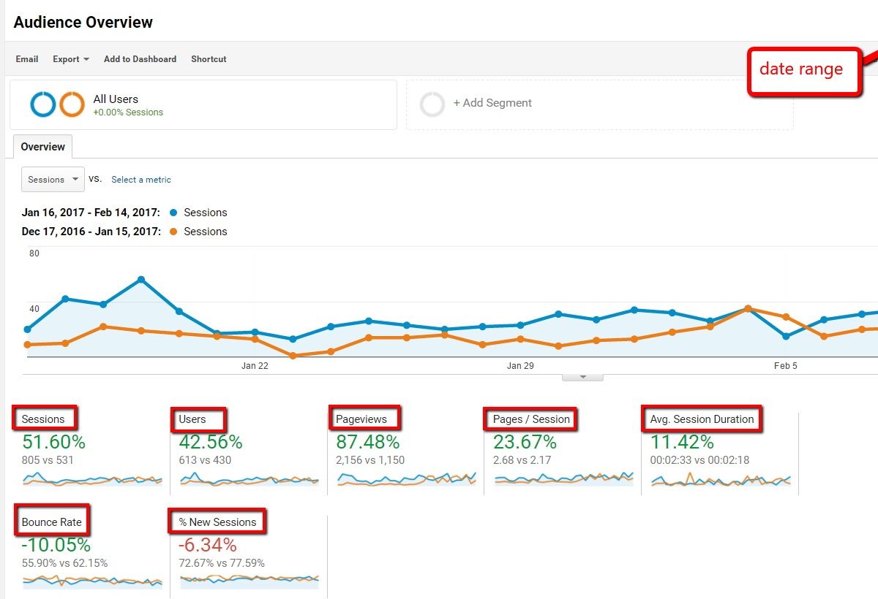
AUDIENCE OVERVIEW
As soon as you log into Google Analytics, you will automatically see your website traffic audience overview.

Slide 5
Total sessions
An increase will be shown in green and a decrease in total sessions will be shown in red.

Slide 6
Total users
Green reflects an increase in numbers, while red shows a decrease in users.

Slide 7
Page Views and Average Pages per
More is better

Slide 8
Average session duration
Usually you would be looking for an increase (green) because that means more time is being spent on your site reading your content or simply browsing.
If you’ve recently reorganized your site to make it easier to find popular pages, you may see a decrease in time on site — that would be a good sign that visitors are finding what they want faster.

Slide 9
BOUNCE RATE
You’ll want to see bounce rate decrease.
A bounce is when a visitor comes to your site and leaves without visiting a second page before exiting.
Decreasing bounce rate is green while increasing bounce rate is red.
Average website bounce rate is 50%, but the lower the bounce rate the better.

Slide 10
Percentage of new sessions
The more new sessions the better: that means more people, who’ve never been to your site before, are visiting your website.

Slide 11
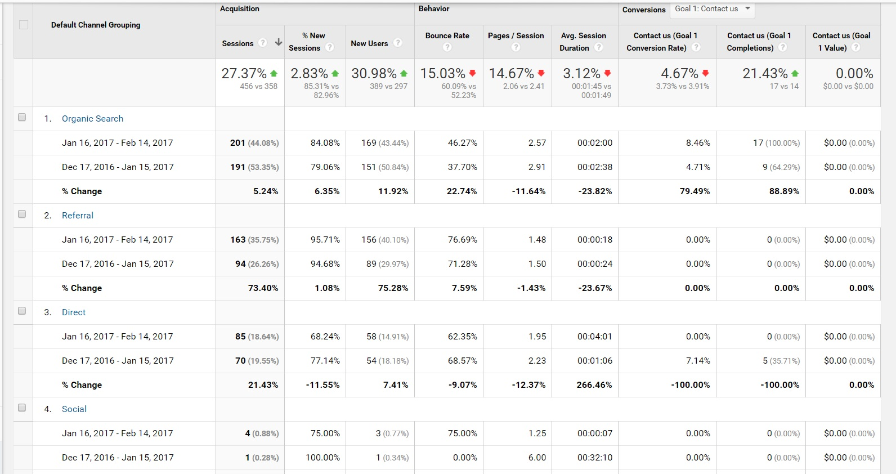
ACQUISITION
The best view is Acquisition > All Traffic > Channels.
Notes:
The Acquisition section shows how website visitors found your site. It lets you know if they found your site through a search, from a social network, whether they typed the URL into the address bar, or if they were referred from another website. Acquisition is important because it lets you know what marketing initiatives are actually driving traffic to your site. The best view is Acquisition > All Traffic > Channels.

Slide 12
Direct
This is when a visitor types in your website URL to go directly to your website.
Notes:
The Acquisition section shows how website visitors found your site. It lets you know if they found your site through a search, from a social network, whether they typed the URL into the address bar, or if they were referred from another website. Acquisition is important because it lets you know what marketing initiatives are actually driving traffic to your site. The best view is Acquisition > All Traffic > Channels.

Slide 13
Social Network
This is when a visitor is on one of your social networks and then links over to your site. This is why it’s important that you leverage social networks to link people to your website.
Notes:
The Acquisition section shows how website visitors found your site. It lets you know if they found your site through a search, from a social network, whether they typed the URL into the address bar, or if they were referred from another website. Acquisition is important because it lets you know what marketing initiatives are actually driving traffic to your site. The best view is Acquisition > All Traffic > Channels.

Slide 14
Referral
This is when a visitor arrives at your site from another website (through a link).
Notes:
The Acquisition section shows how website visitors found your site. It lets you know if they found your site through a search, from a social network, whether they typed the URL into the address bar, or if they were referred from another website. Acquisition is important because it lets you know what marketing initiatives are actually driving traffic to your site. The best view is Acquisition > All Traffic > Channels.

Slide 15
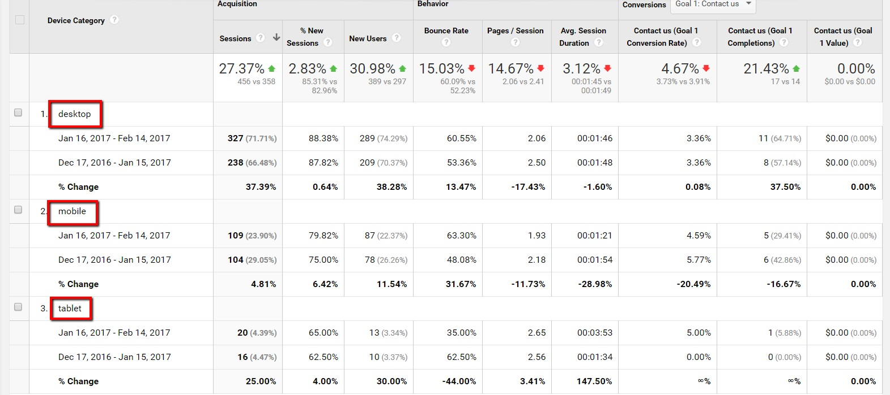
DEVICE
Understanding the device that your site is accessed from helps you ensure the user experience is positive for all devices that drive traffic to your site.
Notes:
Using Google Analytics, you can see what device visitors are accessing your site from. Whether it be a desktop/laptop, tablet, or smartphone, understanding the device that your site is accessed from helps you ensure the user experience is positive for all devices that drive traffic to your site. It’s usually a combination of all 3 and you can access this view by clicking on Audience > Mobile > Overview:

Slide 16
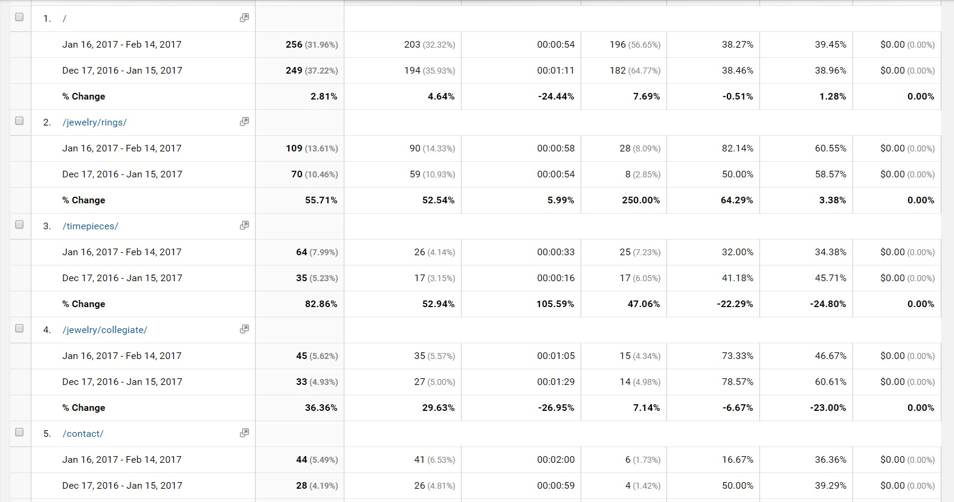
MOST VISITED PAGES
To see what are the most popular pages in your Google Analytics dashboard easily, go to Behavior > Site Content > All Pages.
Notes:
Using Google Analytics, you can see what device visitors are accessing your site from. Whether it be a desktop/laptop, tablet, or smartphone, understanding the device that your site is accessed from helps you ensure the user experience is positive for all devices that drive traffic to your site. It’s usually a combination of all 3 and you can access this view by clicking on Audience > Mobile > Overview:

Slide 17
Think, Write, Pair, Share
What key information do you want to see from the Analytics?
Why is knowing this important?

Slide 18
Use your own Analytics report
Analyze (collect responses as summative assessment):
What is going well?
What key takeaways do you see?
What changes to your website might you make?
What changes to your coverage might you make?

