Slide 1
WordPress
Web

Slide 2
WordPress
Blogging system with full content management
Personal publishing system
Built on PHP scripting language and MySQL relational database management system

Slide 3
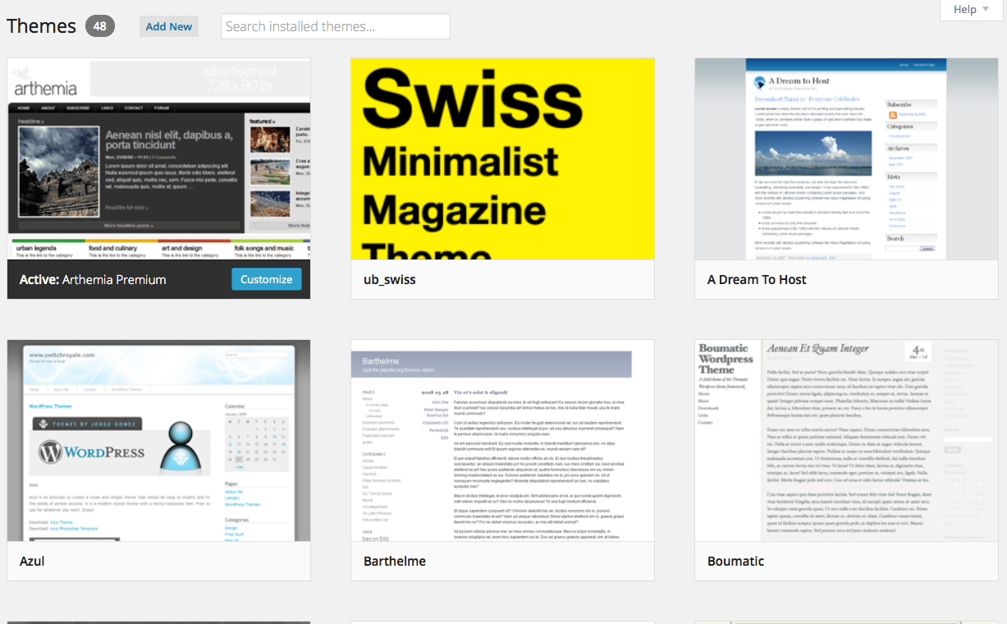
Word Press Themes
There are a variety of WordPress themes on http://wordpress.org
Themes are sorted by popular tags such as education, CMS, technology, etc.
Some of the templates are free and some have a fee associated with them.
To add more functionality, a paid theme may allow for more options.
Variety of Themes

Slide 4
Word Press is easy to use
Websites can be customized with school colors, logos, and buttons for your publication without having to know a lot of HTML or CSS code.

Slide 5
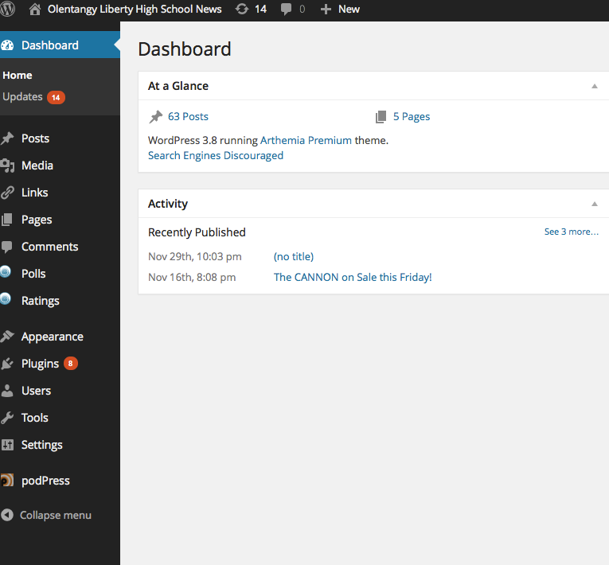
Dashboard
The dashboard is the screen for navigating through a WordPress site.
It is the first screen visible when logging in to the administrative portion of the site.
For more information:
http://codex.wordpress.org/Dashboard_Screen

Slide 6
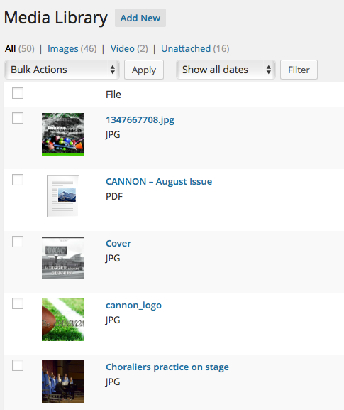
Media Library
Uploading images, audio and video are easy to upload into the media library.
Media items can be embedded into a post or a page.
Media Library is also searchable.

Slide 7
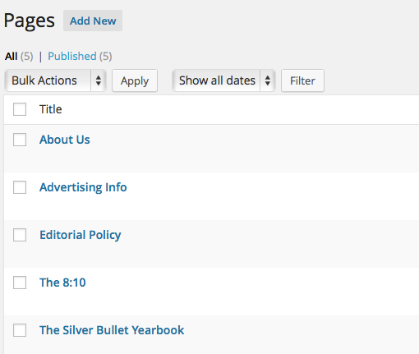
Pages in WordPress
In WordPress, a page can be a static web page (such as the pages listed on the right). Pages are for content such as "About," "Contact," etc.
Depending on the template, pages can also contain individual posts.
Pages can be organized into pages and subpages.
For more information on pages, visit codex.wordpress.org/Pages

Slide 8
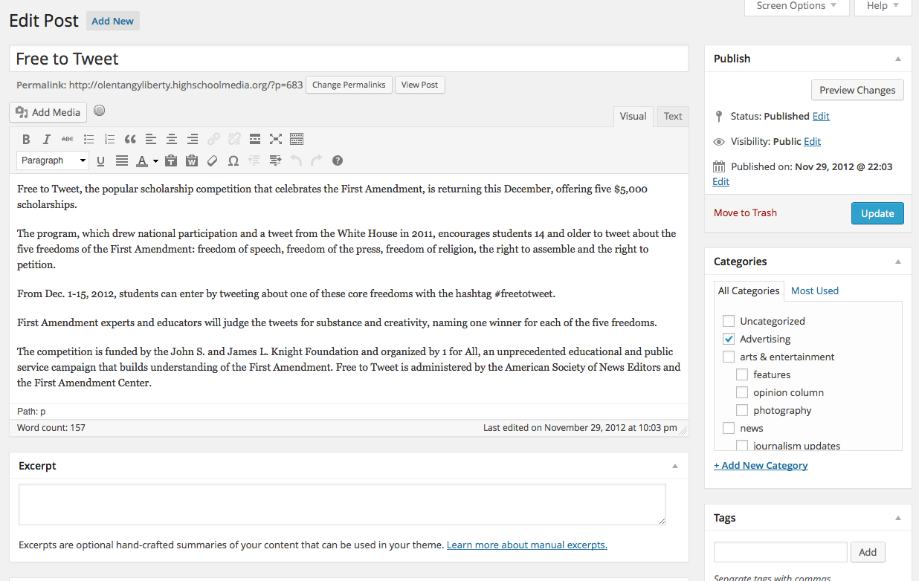
Posts
Posts are the entries that display in reverse chronological order on your home page.
In contrast to pages, posts usually have comments fields beneath them and are included in your site's RSS feed.

Slide 9
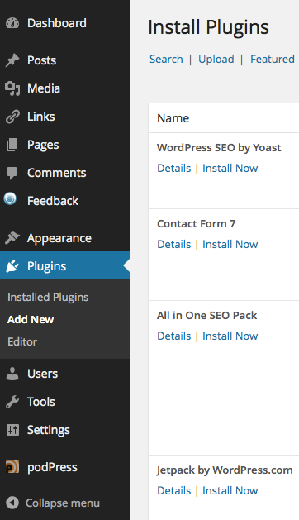
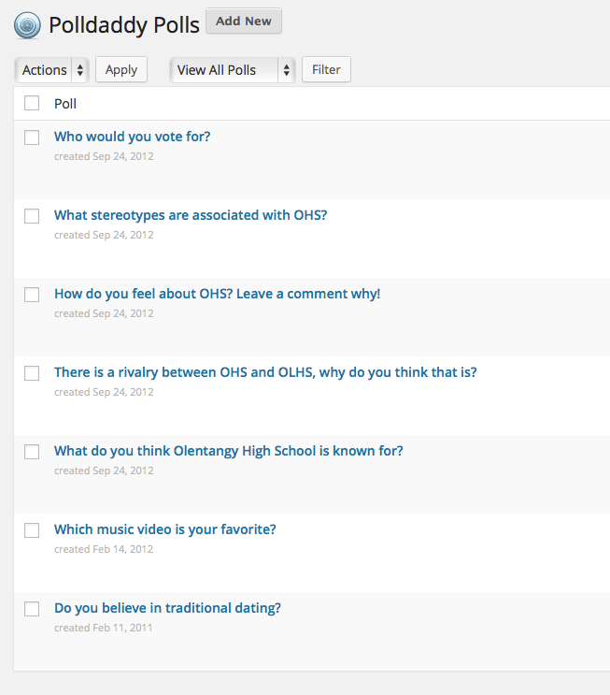
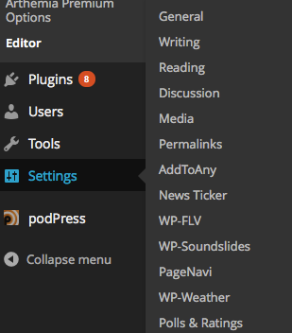
Plug-ins
Plugins are tools to extend the functionality of WordPress.
http://codex.wordpress.org/Plugins

Slide 10
Hosting
http://wordpress.org/hosting/
To run WordPress your host just needs a couple of things:
▪ PHP version 5.2.4 or greater
▪ MySQL version 5.0 or greater
The requirements have changed as of WordPress 3.2. The minimum requirements for WordPress 3.1 are PHP 4.3 and MySQL 4.1.2.
Word Press also recommends ApacheWord Press also recommends Apache or Nginx server for running WordPress, but any server that supports PHP and MySQL will do.

